Slide 1
Setting-up a Consolidated Collection Facility
Mark A. King,
Organics Management Specialist
Division of Materials Management

Slide 2
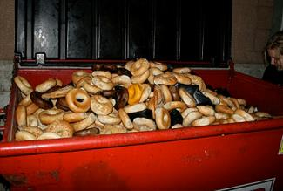
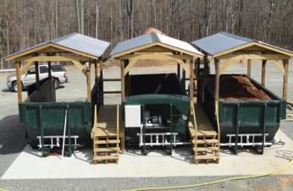
Consolidated Collection Center
Simply put…Food Scrap Transfer station
Provides one central location to build-up collection
Ideal for rural communities that lack space for full-scale compost facility
Materials are covered each day (odor/vectors)
Once full, roll-offs are taken to larger facility for processing
Regulated under Department Rule Chapter 402, “Transfer Stations and Storage Sites for Solid Waste”

Slide 3
Benefits of Consolidated Collection
Allow accumulation of adequate volumes of organics, making trucking economically feasible;
Allow residents to source-separate and collect food from home and bring it to one central location for delivery to a higher end-use;
Helps to fulfill the demand for organics inputs at larger processing facilities; and
Enhanced organics collection bolsters state’s recycling rate.

Slide 4
What Can Be Collected?
The following items should be targeted for collection:
Fruits and vegetables;
Pasta and bread;
Egg shells, seafood (including shells);
Meat and fish (including bones);
Coffee grounds
Stay away from the following contaminants:
Liquid materials (dairy and fryolator grease);
Pet wastes (dog and cat specifically);
Unbleached paper napkins;
Soiled pizza boxes;
Diapers and sanitary napkins;
Some compostable plates, cups and utensils; and
Glass, plastic or metals of any kind.
Allow accumulation of adequate volumes of organics, making trucking economically feasible;
Allow residents to source-separate and collect food from home and bring it to one central location for delivery to a higher end-use;
Helps to fulfill the demand for organics inputs at larger processing facilities; and
Enhanced organics collection bolsters state’s recycling rate.

Slide 5
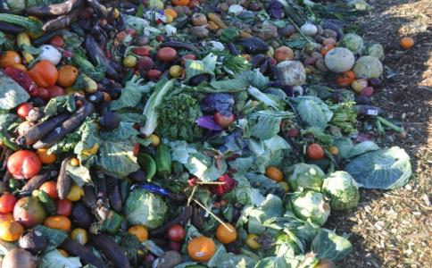
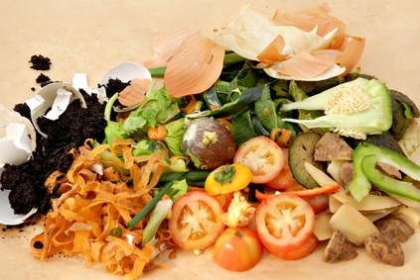
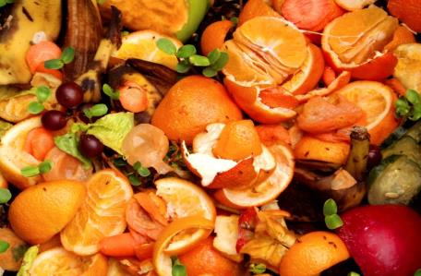
Type IB
MAINE DEPARTMENT OF ENVIRONMENTAL PROTECTION www.maine.gov/dep

Slide 6
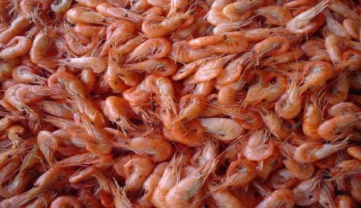
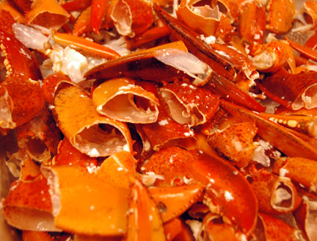
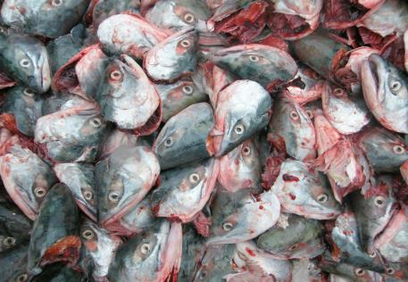
Type IC
MAINE DEPARTMENT OF ENVIRONMENTAL PROTECTION www.maine.gov/dep

Slide 7
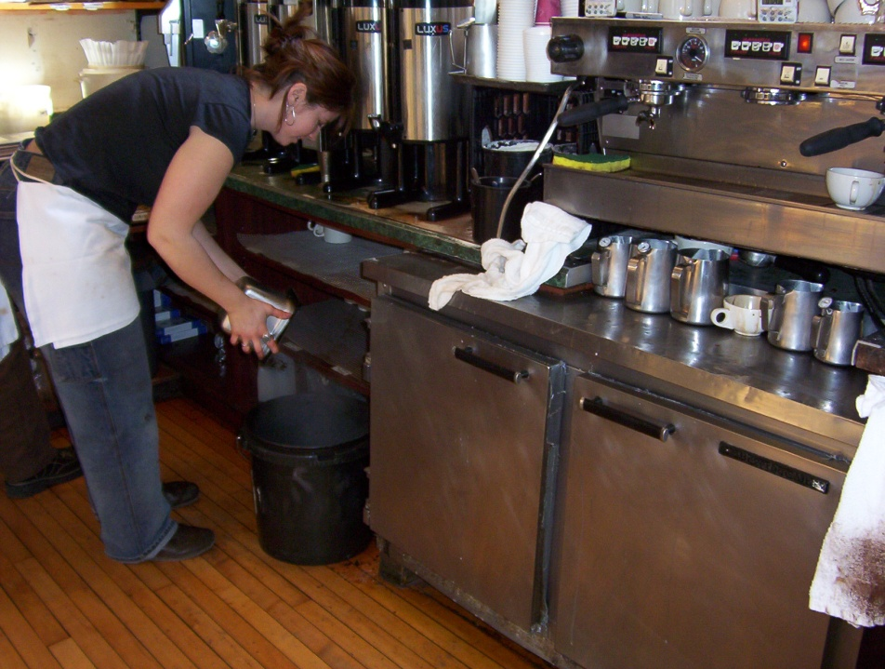
Training Staff….
An Exercise in “Patience”

Slide 8
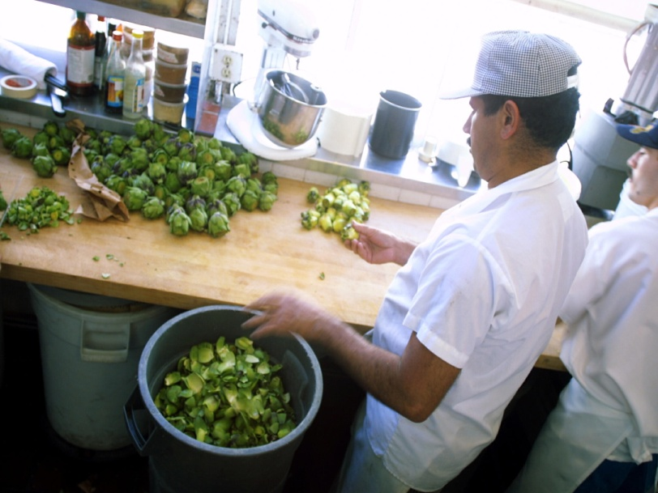
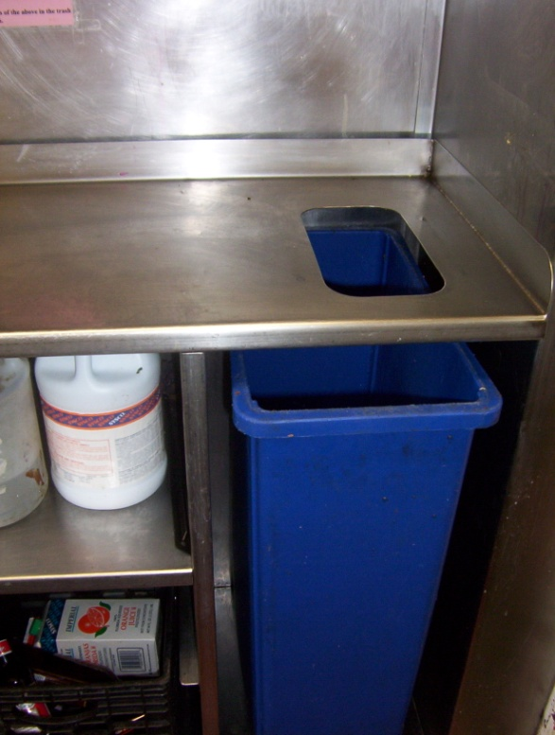
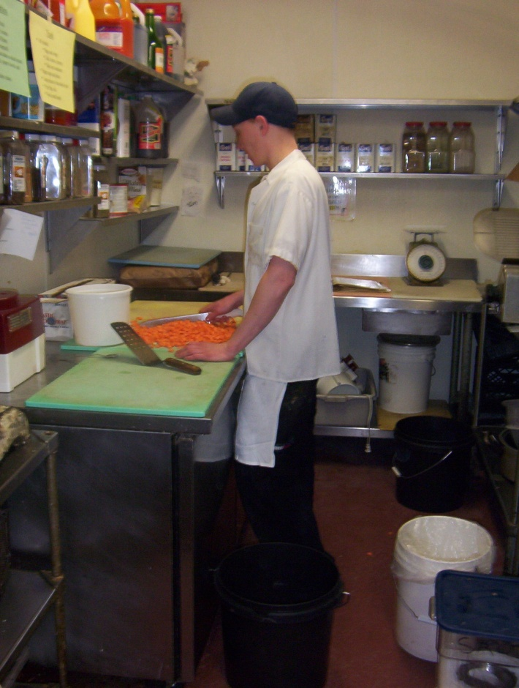
Food Recovery-Kitchen Prep.
“Pre-Consumer”

Slide 9
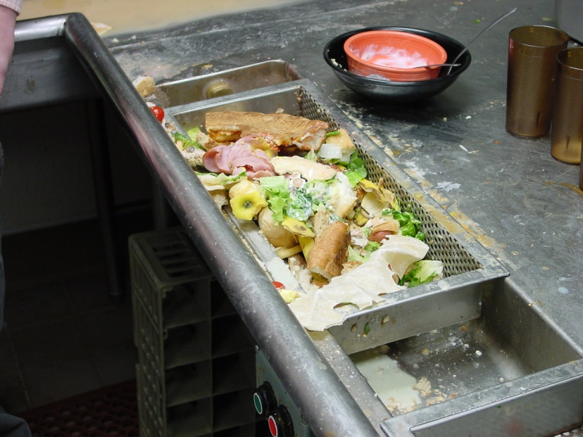
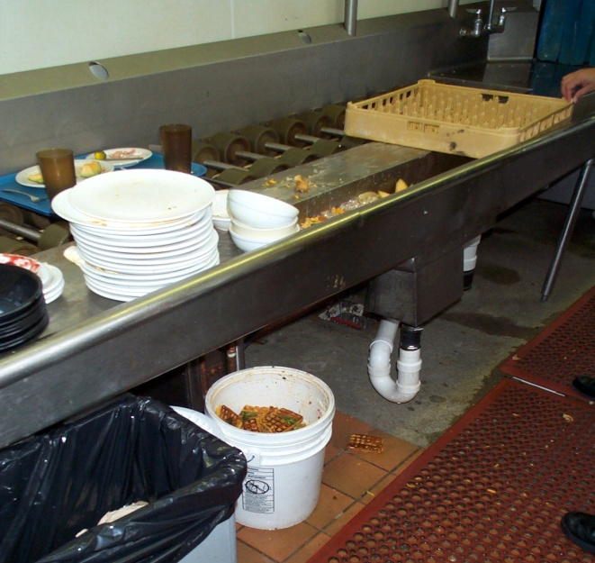
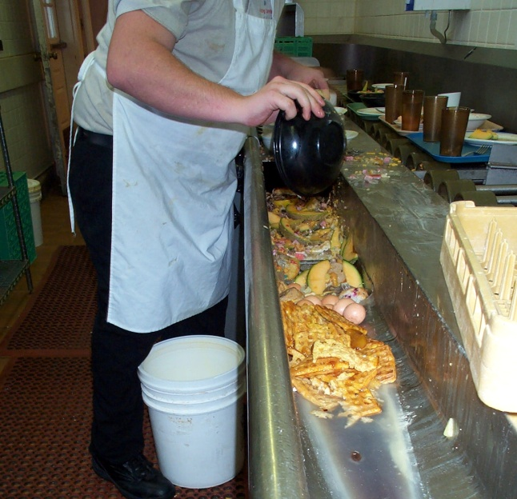
Food Recovery-Plate Scrapings
“Post-Consumer”

Slide 10
Separation
Logistics are not that difficult
Long-term consistency is very difficult
Permanent feedback loop is needed to correct problems quickly
How to institutionalize organics recycling?

Slide 11
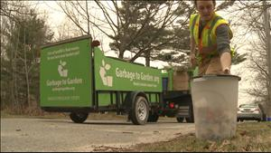
Residential: Curbside picked weekly…

Slide 12
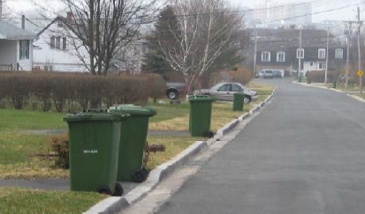
Residential: Large Scale

Slide 13
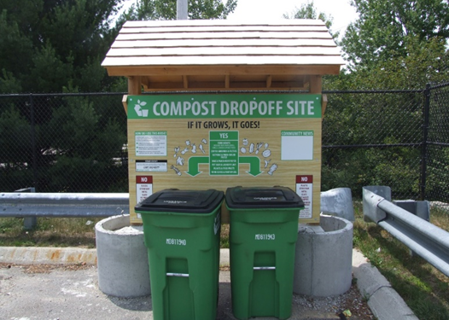
Stand-alone Collection Sites
MAINE DEPARTMENT OF ENVIRONMENTAL PROTECTION www.maine.gov/dep

Slide 14
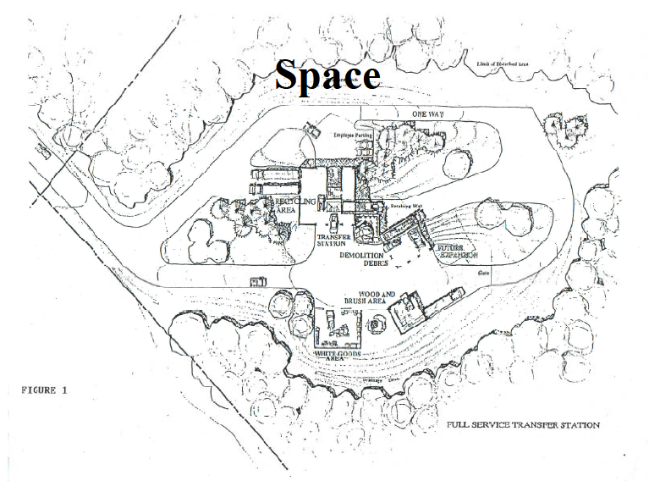
Do You Have Room?

Slide 15
General Facility Layout Requirements
Area Requirement | Cart (96 Gallon) | Front-Load (up to 6 yd³) | Roll-Off (20 yd³)
Footprint | 3-4 ft² | 30-40 ft² | 175-200 ft²
Vertical Clearance | 15-25 feet | 15-25 feet | 25-30 feet
Dimensions | 30-40 feet long 10-15 feet wide | 30-40 feet long 15-20 feet wide | 40-50 feet long 15-20 feet wide
Allow accumulation of adequate volumes of organics, making trucking economically feasible;
Allow residents to source-separate and collect food from home and bring it to one central location for delivery to a higher end-use;
Helps to fulfill the demand for organics inputs at larger processing facilities; and
Enhanced organics collection bolsters state’s recycling rate.

Slide 16
Regulatory Requirements
Regulated under Chapter 402, “Transfer Stations and Storage Sites for Solid Waste”. Mechanisms for approval may vary.
Existing facility: Update to the facility Operations Manual, a Minor Revision or an Amendment to the license;
A new site may require a full Chapter 402 license;
Stand-alone collection sites (kiosks) not at a licensed facility may be registered using a form provided by the Department.
MAINE DEPARTMENT OF ENVIRONMENTAL PROTECTION www.maine.gov/dep

Slide 17
What About The Public?
Does Perception = Reality??

Slide 18
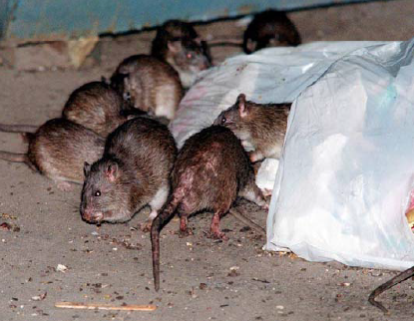
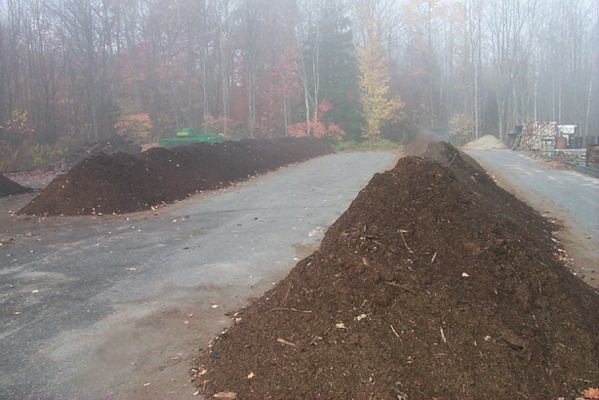
Public Perception
How Do You Go From This?
To This?

Slide 19
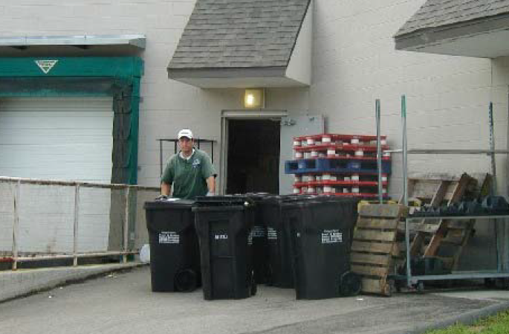
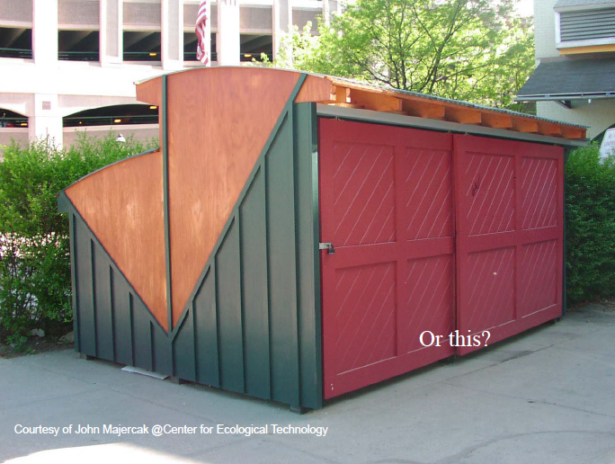
Emphasize Proper Management

Slide 20
Options for Collected Scraps?
Compost onsite = Most efficient option
Compost offsite = Requires Transport
Community-based site
On Farm Compost Site (Compost Management Plan)
Take to Anaerobic Digester (Offsite)
Requires Transport—several programs available

Slide 21
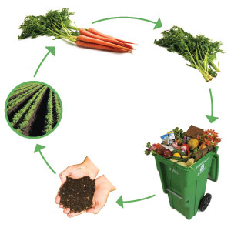
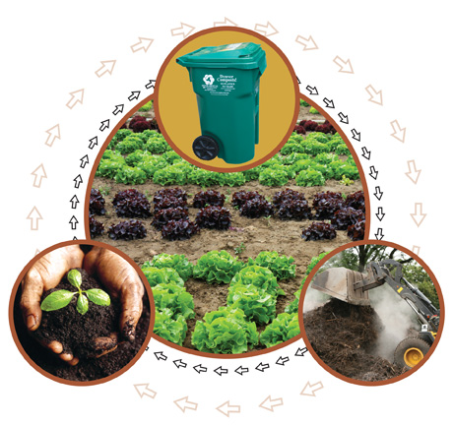
Composting

Slide 22
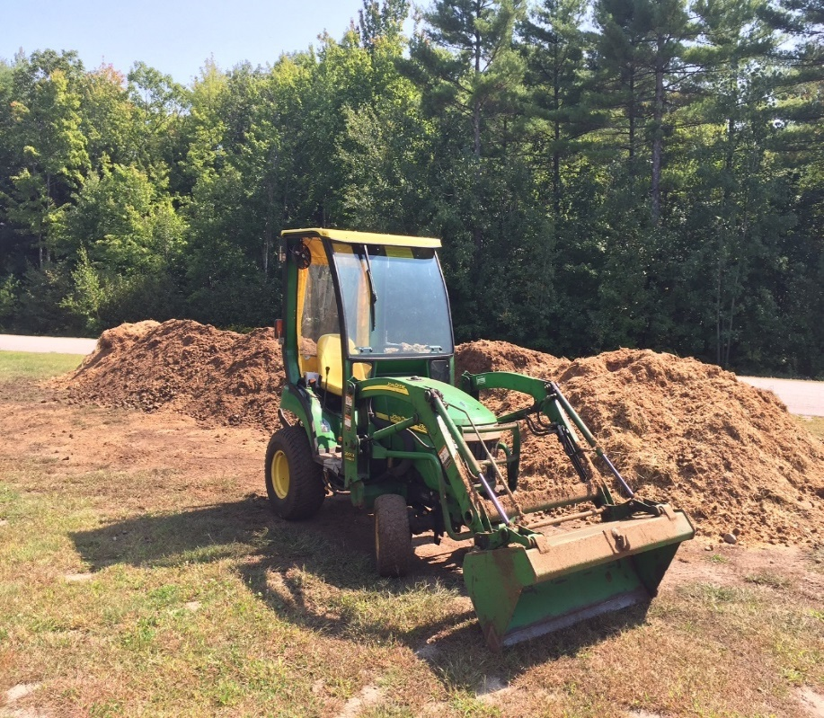
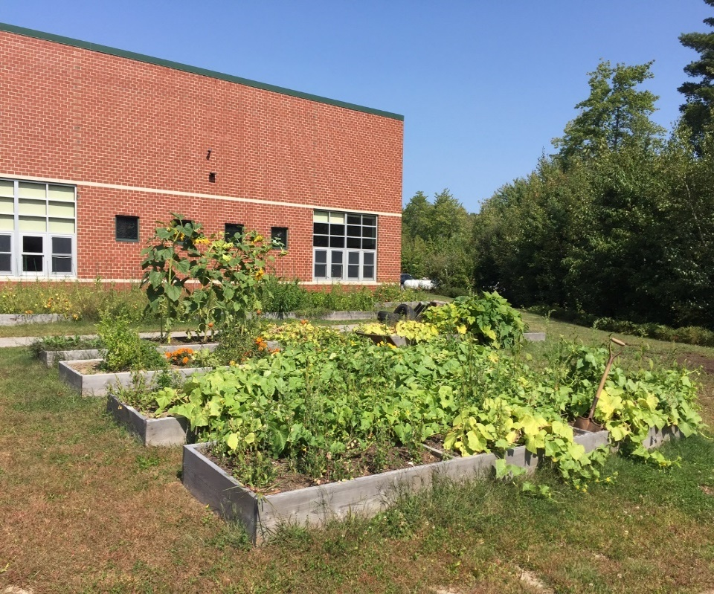
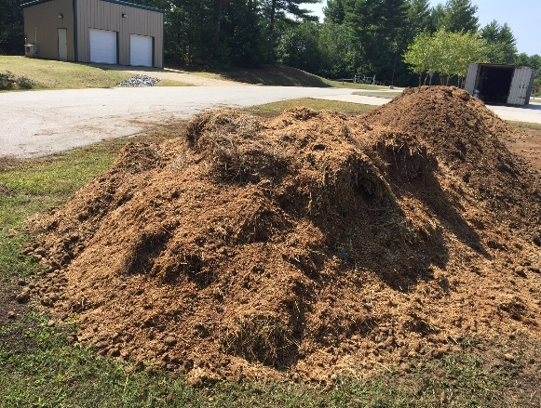
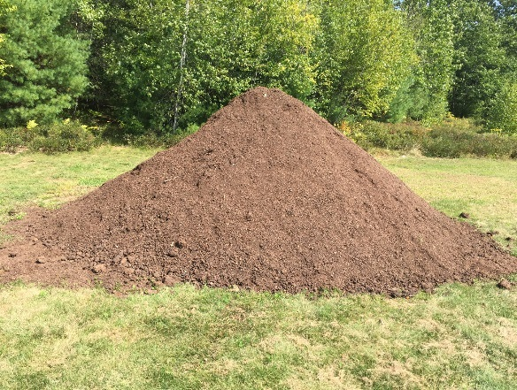
Massabesic Middle School
Food Scrap Compost Pilot
2016-2017

Slide 23
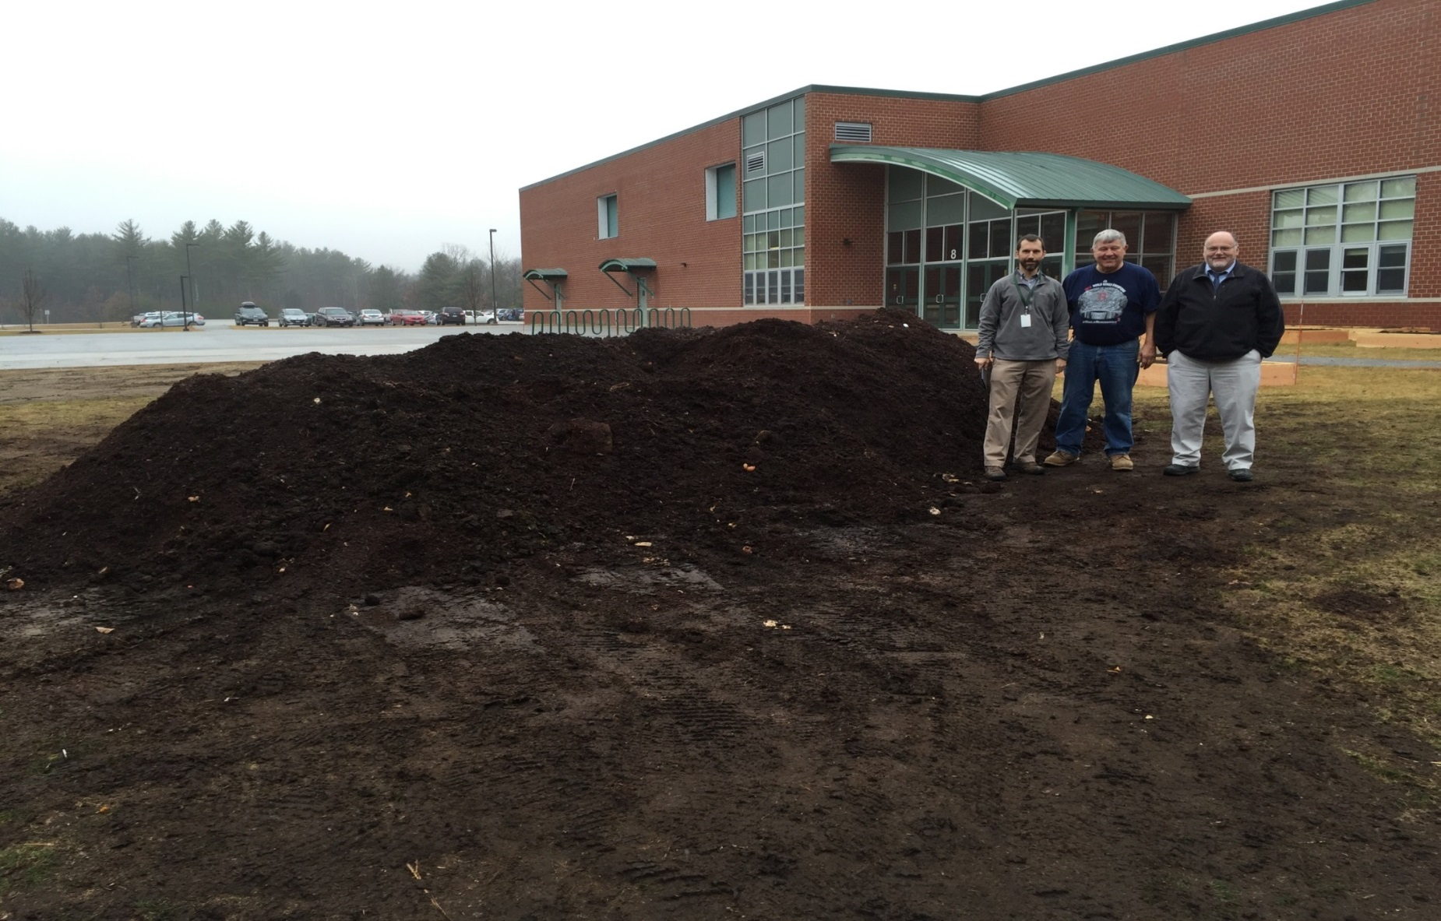
Composting ‘on-site’ at Massabesic Middle School, Waterboro

Slide 24
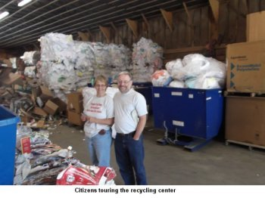
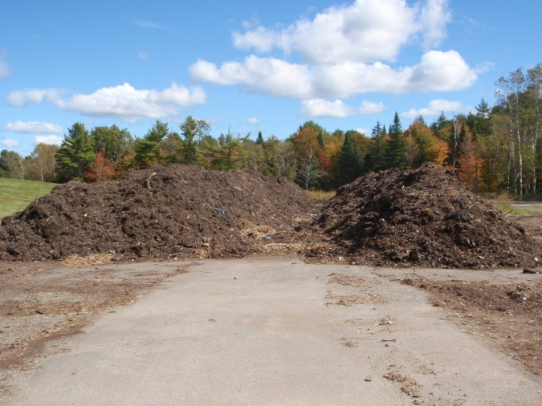
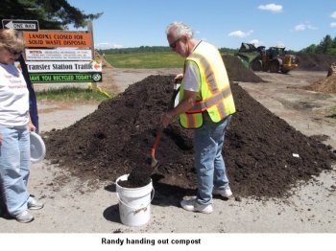
Pilot Projects-Town of Skowhegan

Slide 25
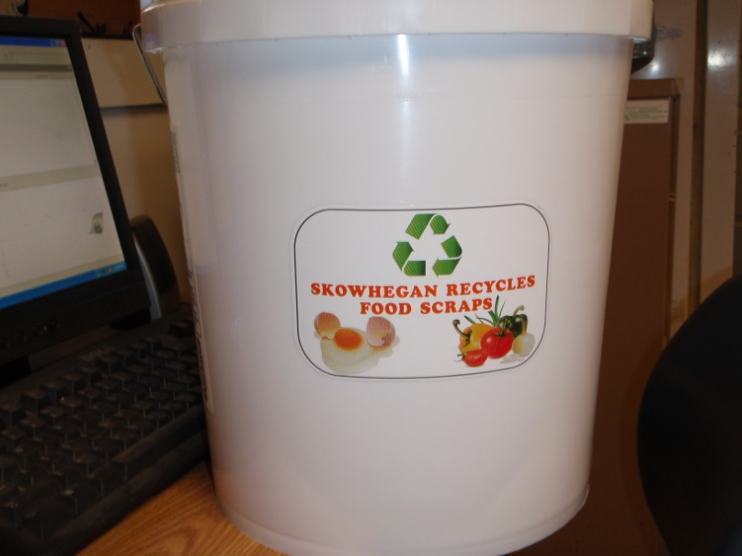
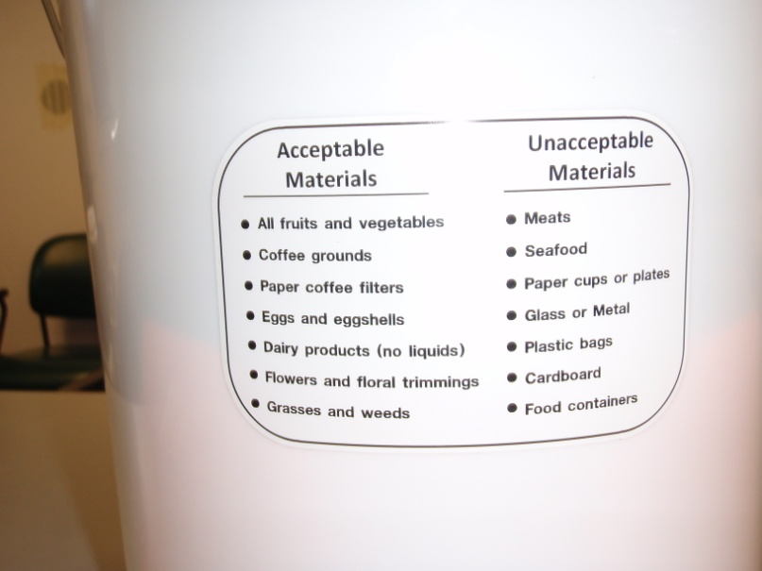
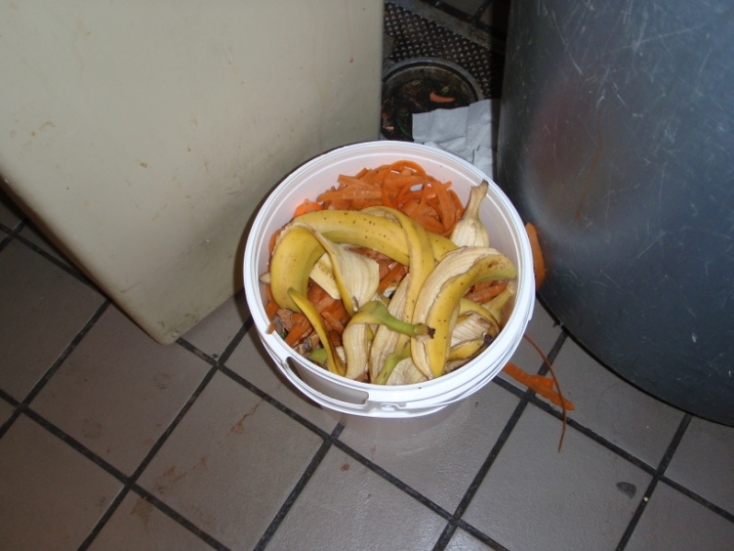
2013 Food Scrap Recovery Program

Slide 26
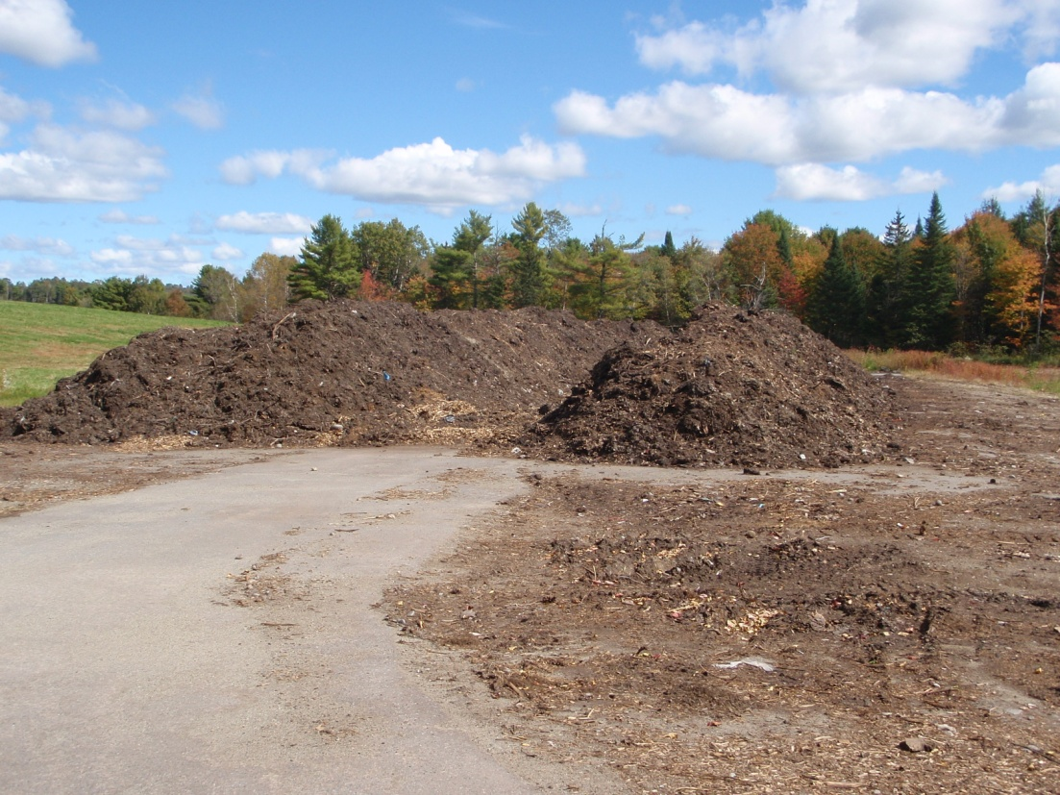
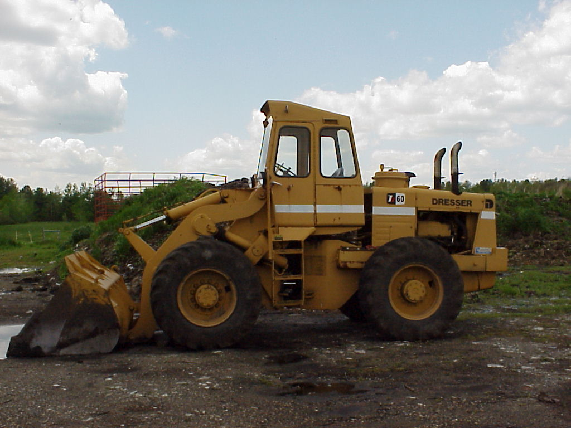
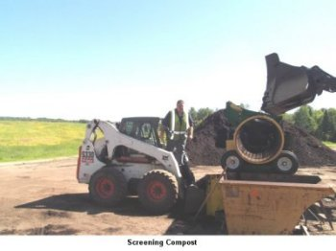

Slide 27
Staying out of Trouble
Keep collection site clean and free of litter;
Make sure that containers have tight-fitting lids;
Remove organics at least once weekly and more frequently during the summer months;
If you notice odors or leachate, amend with absorbent material (carbon); and
If you reach out for help when problems first begin, you will have a much better outcome.

Slide 28
In Closing…
The best waste reduction plan is to avoid creating it in the first place!
Follow food re-use hierarchy.
Identify obstacles and develop ways to overcome.
Create a program that benefits many.
Have fun doing it!!!

Slide 29
www.maine.gov/dep

