Slide 1
Shoreland Zoning Guidelines
KVCOG Shoreland Zoning Training
2024
Colin Clark
Shoreland Zoning Coordinator
MAINE DEPARTMENT OF ENVIRONMENTAL PROTECTION
Protecting Maine’s Air, Land and Water
Notes:
Introduction: DEP, SZ

Slide 2
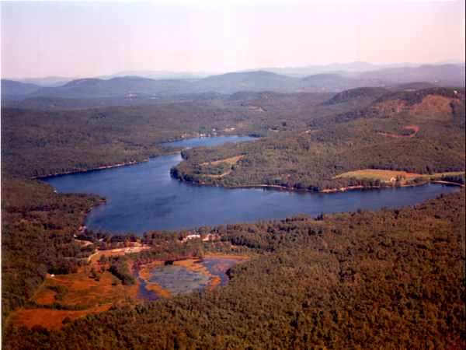
Shoreland Zoning Applicability
Great ponds
Streams
Rivers
Coastal wetlands
Freshwater wetlands
(all defined, and all
depicted on SLZ map)
MAINE DEPARTMENT OF ENVIRONMENTAL PROTECTION www.maine.gov/dep
Notes:
Great ponds have surface area of 10+ acres or 30+ acre impoundments.
Streams start at the confluence of two perennial streams or the outlet of a great pond
Rivers begin where it drains 25 square miles
Coastal wetlands include all areas below the highest annual tide, including tidal portions of rivers.
Freshwater wetlands are 10+ acre wetlands

Slide 3
MAINE DEPARTMENT OF ENVIRONMENTAL PROTECTION www.maine.gov/dep
Notes:
Remember to always refer to the local shoreland zoning ordinance and map!
Note that intermittent and perennial streams have no shoreland zone.
The shoreland zone of streams is only 75 feet from the shoreline.
Within the shoreland zone, tributary streams do not have their own shoreland zone but there are setback requirements from their shoreline.
Wetland areas that are contiguous with great pond and rivers are part of great ponds and rivers, and the shoreline is measured as the upland edge of those wetland areas. Rivers also include floodplain wetlands.

Slide 4
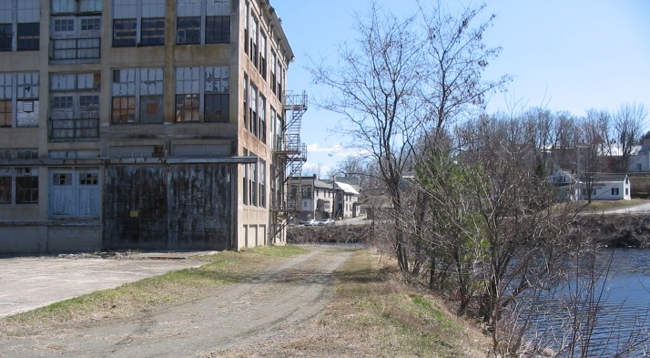
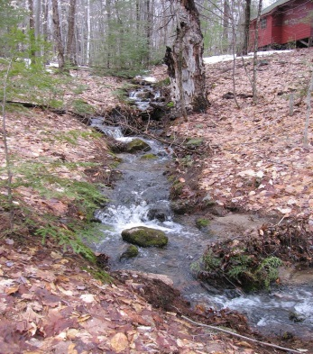
Shoreline Setbacks for Structures
Setback depends on resource, use and district:
Great ponds and rivers to great ponds 100ft
Other rivers, streams and wetlands 75ft
Tributary streams (within shoreland zone) 75ft
General Development II District 75ft
General Development I District 25ft
Functionally water-dependent uses 0ft
MAINE DEPARTMENT OF ENVIRONMENTAL PROTECTION www.maine.gov/dep
Notes:
Uses not allowed in RP effectively have a 250-foot setback.
Describe GD I & II
CFMA designed for only functionally water-dependent uses, so no setback.

Slide 5
Amendment Process
Who will be involved:
Planning board or a committee task?
Appoint a drafter (computer user)
Other officials, for getting public input?
Assistance from shoreland staff:
Review draft amendment language
Discuss pros and cons of various options
Advise on any necessary map amendments
MAINE DEPARTMENT OF ENVIRONMENTAL PROTECTION www.maine.gov/dep
Notes:
DEP can provide draft language and additional options that are not contained in the 2015 Guidelines

Slide 6
Local Procedures
Determine timeline, work backwards from:
Date of adoption (town meeting / council vote)
Warrant/agenda deadline
Required public hearing
Public/individual notices
PB consideration/passage?
Map refinement
DEP draft review?
Map drafted
Ordinance drafted
MAINE DEPARTMENT OF ENVIRONMENTAL PROTECTION www.maine.gov/dep
Notes:
Shoreland staff can review drafts upon request, serve as translators between officials and mappers, guide the mapper to data needed

Slide 7
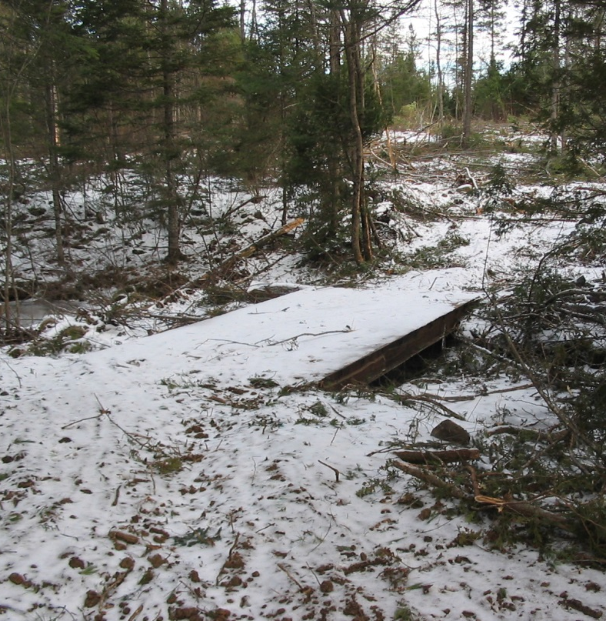
Following Through
After local adoption:
Submit copy of amendments, attested by the clerk
45-day review period
Receive DEP Order
Contact Maine Forest Service
If conditional approval:
Notice of DEP Order first
Contact shoreland staff with concerns
Attach conditions to ordinance
MAINE DEPARTMENT OF ENVIRONMENTAL PROTECTION www.maine.gov/dep
Notes:
Hard copies. Either identified amendments or statement of full ordinance submitted for review. Map size.
Review period begins upon receipt of attested copies.
Shoreland staff notify MFS of option, but if option 2 then contact MFS for agreement.
Don’t make changes required by conditions, that requires adoption, just attach conditions for administration.

Slide 8
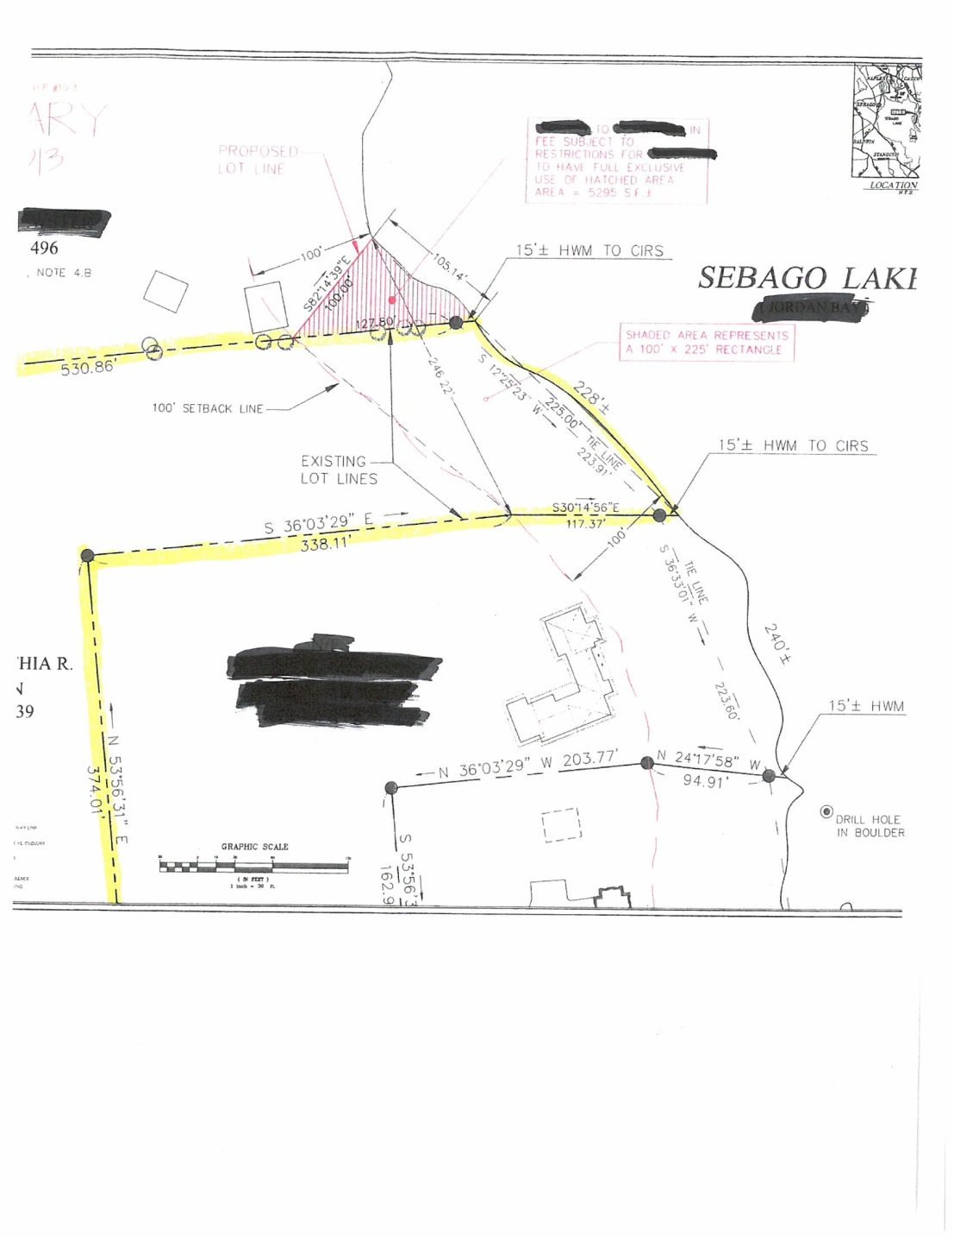
Minimum Lot Standards
Minimum lot standards required for each principal structure and/or use
Lot area
Minimum lot width
Shore frontage
MAINE DEPARTMENT OF ENVIRONMENTAL PROTECTION www.maine.gov/dep
Notes:
Lot standards include lot area, lot width and shore frontage. The minimums are required for each and every principal use.
Lot area does not include the land below the shoreline and beneath a road.
Lot width is measured as the closest distance between the two side lot lines everywhere within 100 feet of the shoreline.
Shore frontage is measured in a straight line between the intersections of lot lines with the shoreline, not like realty measurement.

Slide 9
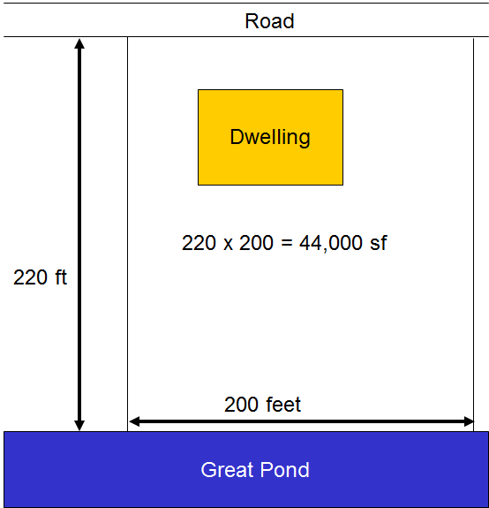
Lot Area
Required lot area depends on:
Proposed use
Type of resource (tidal vs. non-)
CFMA district designation
Lot area defined:
Excludes land below the shoreline
Excludes land w/in a wetland
Excludes land beneath a road
MAINE DEPARTMENT OF ENVIRONMENTAL PROTECTION www.maine.gov/dep
Notes:
Lot area required per principal structure/use
Lot area does not necessarily equate taxed or deeded land area

Slide 10
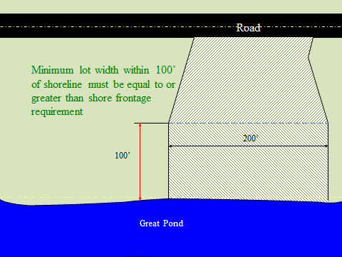
Lot Width
Minimum lot width:
Measured as closest distance between the side lot lines
Applies within 100 feet of the shoreline
Varies with shore frontage requirements
MAINE DEPARTMENT OF ENVIRONMENTAL PROTECTION www.maine.gov/dep
Notes:
Any portion of the lot within 100 feet must meet the requirement, not just one point within 100 feet.
Lot does not have to include / be on the shoreline.

Slide 11
Shore Frontage
Shore frontage required:
Varies with lot area requirements
Measured in a straight line between the intersections of the lot lines with the shoreline
Not the same as realty frontage
MAINE DEPARTMENT OF ENVIRONMENTAL PROTECTION www.maine.gov/dep
Notes:
Purpose of shore frontage standard

Slide 12
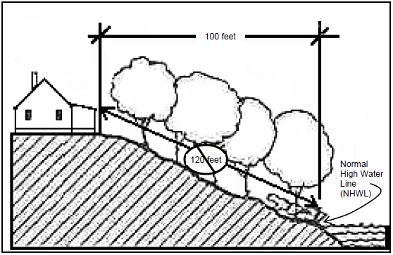
Measuring Setback
Nearest horizontal distance from the shoreline to nearest part of the structure or other regulated area
MAINE DEPARTMENT OF ENVIRONMENTAL PROTECTION www.maine.gov/dep
Notes:
Nearest means the measurement is not necessary perpendicular to shoreline or structure.
Setback is not measured along the ground.
Nearest part of a dwelling is often the eves, patio or deck.

Slide 13
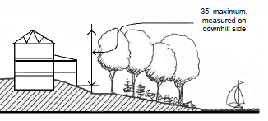
Height of a Structure
Defined as:
Vertical distance between the mean original (prior to construction) grade at the downhill side of the structure and the highest point of the structure
MAINE DEPARTMENT OF ENVIRONMENTAL PROTECTION www.maine.gov/dep
Notes:
In most districts, the height limit is 35 feet.

Slide 14
Height of a Structure In Area of Special Flood Hazard 38 MRSA §439-A (4)(C-1)
“Notwithstanding the limitations on height imposed under paragraphs B and C, (footprint expansion sections) the height of a structure that is a legally existing nonconforming principal or accessory structure may be raised to, but not above, the minimum elevation necessary to be consistent with the local floodplain management elevation requirement or to 3 feet above base flood elevation, whichever is greater as long as the structure is relocated, reconstructed, replaced or elevated within the boundaries of the parcel so that the water body or wetland setback requirement is met to the greatest practical extent.
This paragraph applies to structures that:
Have been or are proposed to be relocated, reconstructed, replaced or elevated to be consistent with the local floodplain management elevation requirement; and
Are located in an area of special flood hazard.
MAINE DEPARTMENT OF ENVIRONMENTAL PROTECTION www.maine.gov/dep
Notes:
In most districts, the height limit is 35 feet.

Slide 15
Height of a Structure In Area of Special Flood Hazard
38 MRSA § 436-A (1-C)
Area of special flood hazard means land in a floodplain having a 1% or greater chance of flooding in any given year, as identified in the effective federal flood insurance study and corresponding flood insurance rate maps.
38 MRSA § 436-A (7-A)
Height means with respect to existing principal or accessory structures, including legally existing nonconforming structures, located within and area of special flood hazard that have been or are proposed to be relocated, reconstructed, replaces or elevated to be consistent with the minimum elevation required by a local floodplain management ordinance, the vertical distance between the bottom of the sill of the structure to the highest point of the structure, excluding chimneys, steeples, antennas and similar appurtenances that have no floor area.
MAINE DEPARTMENT OF ENVIRONMENTAL PROTECTION www.maine.gov/dep
Notes:
In most districts, the height limit is 35 feet.

Slide 16
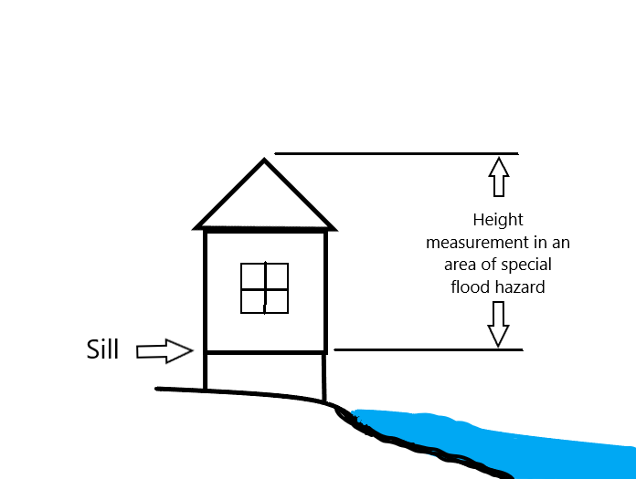
Height of a Structure In Area of Special Flood Hazard
MAINE DEPARTMENT OF ENVIRONMENTAL PROTECTION www.maine.gov/dep
Notes:
In most districts, the height limit is 35 feet.

Slide 17
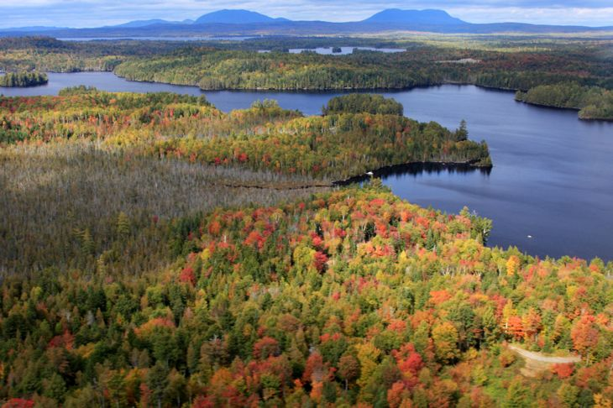
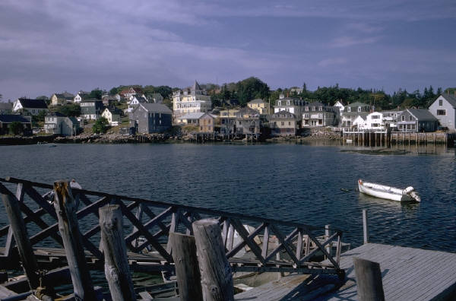
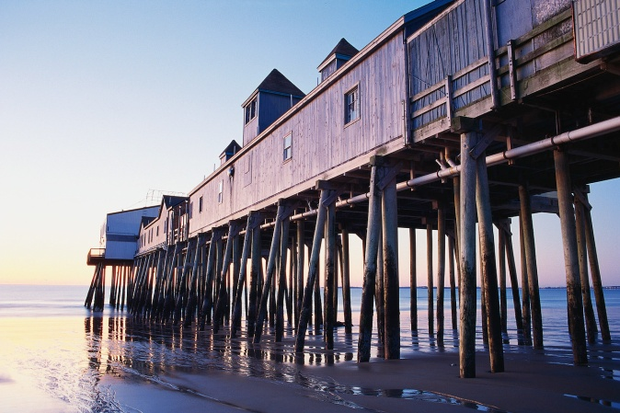
Nonconforming Structures
Legally existing nonconforming structures can be maintained
Legally existing nonconforming structures can be expanded
Relocation requires setback be met to the greatest practical extent
Destruction, removal or damage of more than 50% of the market value of a structure requires relocation to meet structure setback to the greatest practical extent
MAINE DEPARTMENT OF ENVIRONMENTAL PROTECTION www.maine.gov/dep

Slide 18
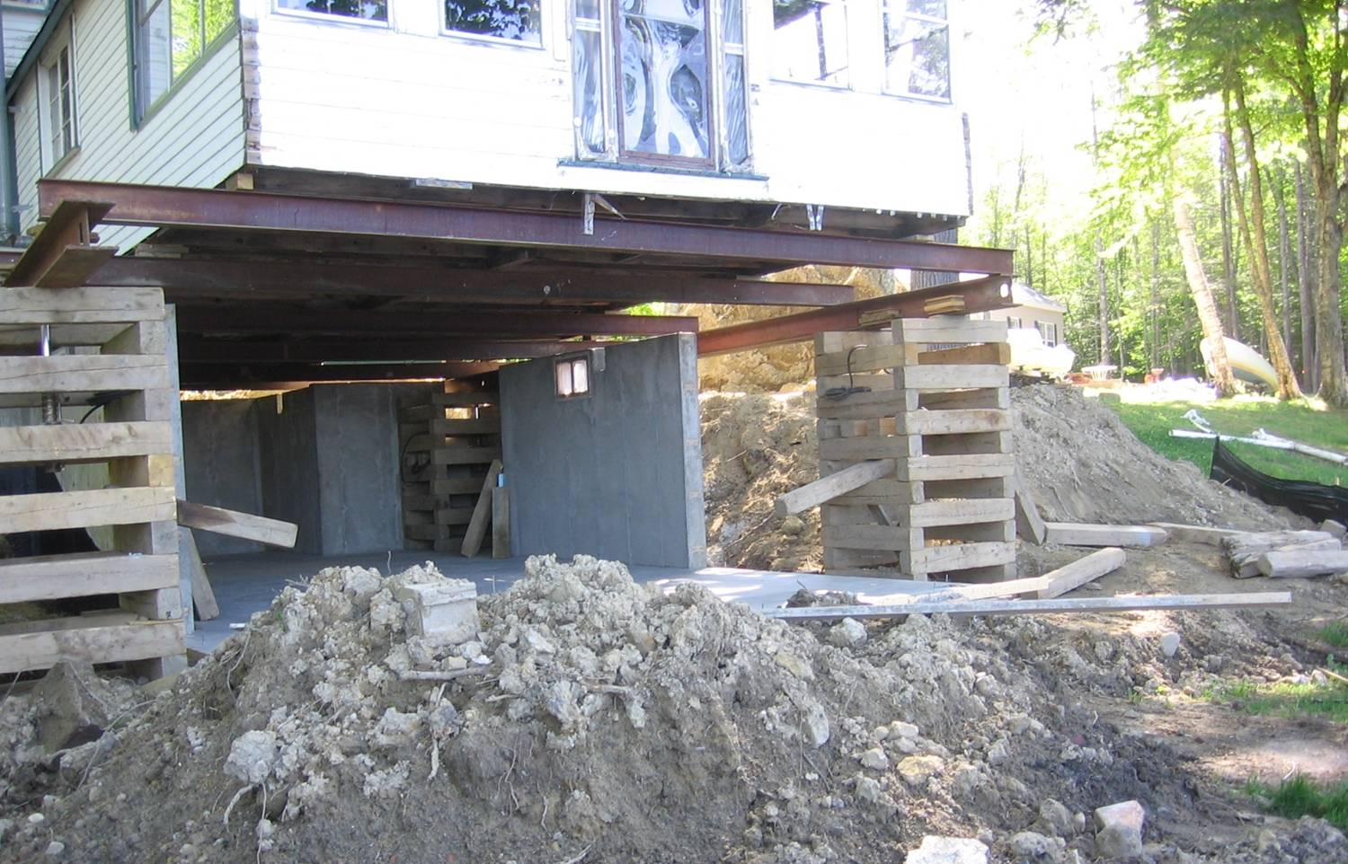
Reconstruction Standards
In-place reconstruction/replacement if:
< 50% of the market value of the structure is removed, damaged, or destroyed
Relocation required if:
> 50% of the market
value of the structure
is removed, damaged,
or destroyed
MAINE DEPARTMENT OF ENVIRONMENTAL PROTECTION www.maine.gov/dep
Notes:
Most projects are obvious, but use your professional judgement.
The applicant has the burden of proof.

Slide 19
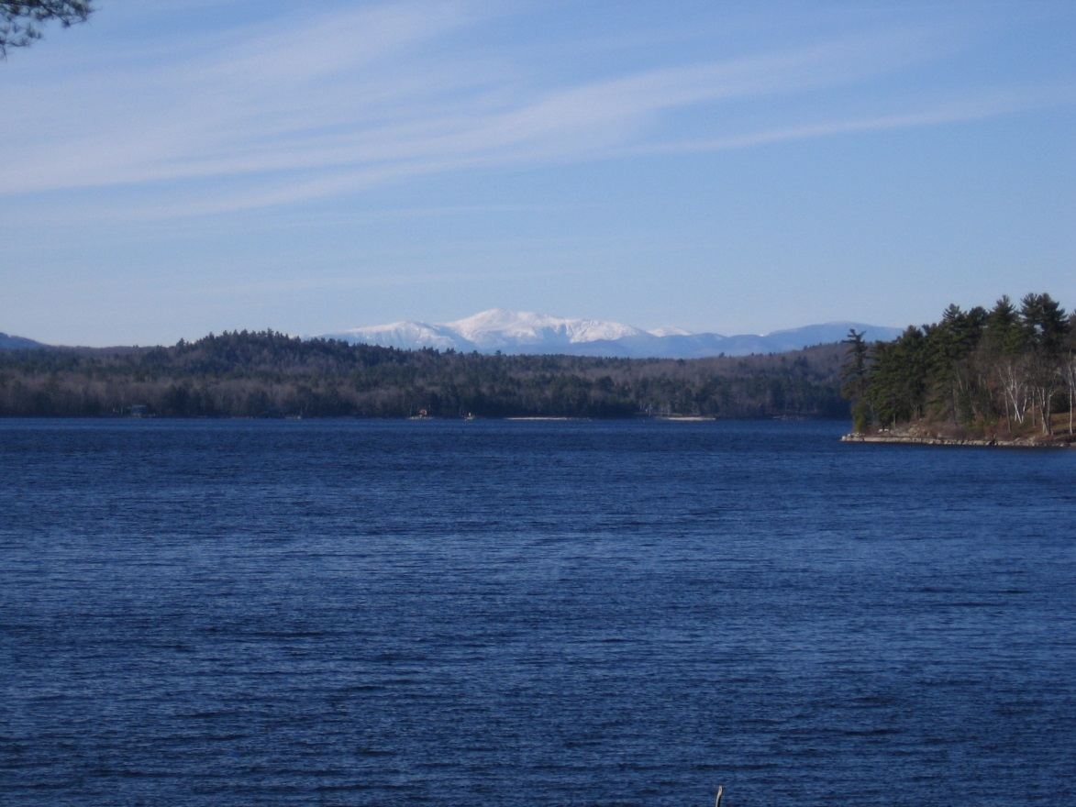
How does one consider “market value”?
Market value relates ONLY to the value of the non-conforming structure. The structure has the exact same value whether it is located such that there is a ‘million dollar view’, or it is located next to the town landfill.
MAINE DEPARTMENT OF ENVIRONMENTAL PROTECTION www.maine.gov/dep
Notes:
Many structures are nonconforming to setbacks

Slide 20
What else about the 50% market value threshold?
“…which is removed, or damaged or destroyed, regardless of the cause, by more than 50% of the market value of the structure before such damage, destruction or removal…”
Does NOT take into consideration material or labor costs
Does NOT apply to basic repair & maintenance (e.g. re-shingling roof)
Consider all elements of projects (e.g. removing roof, sills due to rot, walls due to mold, windows, doors, etc), but avoid absurdity (e.g. removing 2 coats of paint)!
MAINE DEPARTMENT OF ENVIRONMENTAL PROTECTION www.maine.gov/dep
Notes:
Many structures are nonconforming to setbacks

Slide 21
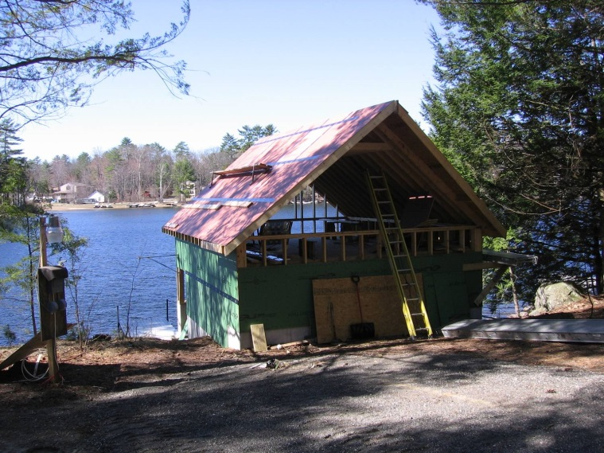
Relocation Review
When relocation is required:
The reviewing authority determines where the existing structure could be relocated to meet the setback to the greatest practical extent
Criteria for making this determination includes:
Characteristics of the land and lot
Locations of existing structures
Existing and future septic systems
The condition of existing foundation
Seek advisory opinions
MAINE DEPARTMENT OF ENVIRONMENTAL PROTECTION www.maine.gov/dep
Notes:
Make sure the application demonstrates all limitations to meeting the setback.
Criteria can be tricky or subjective, so seek assistance when needed.

Slide 22
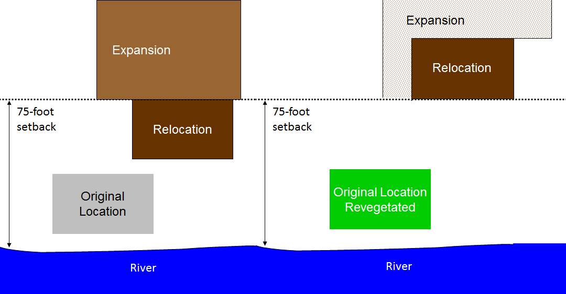
Relocation First
Relocate original structure
to meet setback
Not Greatest Practical Extent
MAINE DEPARTMENT OF ENVIRONMENTAL PROTECTION www.maine.gov/dep
Notes:
When expansion is proposed, and relocation is proposed or required, then the relocation evaluation is done before expansion is considered.
Ordinances amended since 2006 require the original location to be revegetated.

Slide 23
NEW!! Footprint and Height Method
Change from floor area and volume to “footprint” and height- tiered, based on distance from shore
Landowners choose between the cap limit or 30% for footprint, and existing height or height cap
Plans recorded at registry of deeds
Municipal officials may choose to:
Limit expansions by the caps or by 30%, instead of allowing landowner choice
Allow limited expansions within 25 feet of the shoreline
Allow limited expansions in Resource Protection District
MAINE DEPARTMENT OF ENVIRONMENTAL PROTECTION www.maine.gov/dep
Notes:
Difference b/t floor area and footprint
Difference b/t volume and height

Slide 24
What is “Footprint”?
Footprint - the entire area of ground covered by the structure(s) on a lot, including but not limited to cantilevered or similar overhanging extensions, as well as unenclosed structures, such as patios and decks
MAINE DEPARTMENT OF ENVIRONMENTAL PROTECTION www.maine.gov/dep

Slide 25
Other Definitions using “Footprint”
Expansion of a structure, change floor area & volume
Expansion of a use, change floor area
Floor area, remove reference to unenclosed structures
Nonconforming structure, add footprint
MAINE DEPARTMENT OF ENVIRONMENTAL PROTECTION www.maine.gov/dep

Slide 26
Footprint expansion-highlights
Height- existing, or max height:
100 feet
75 feet
25 feet
No expansion unless principal structure entirely w/in 25’, then 800 sf or 30%. No accessory structure expansion.
15 ft
Great Pond
Notes:
This rule is an option for the town to adopt and then administer in place of 30% rule.

Slide 27
Footprint expansion- highlights
Height- existing, or max height:
100 feet
75 feet
Expansion up to 1,000 sf, or 30%, whichever is greater (maximum combined total footprint). No accessory structure expansion if closer to shoreline than principal structure.
20 ft
25 feet
No expansion unless principal structure entirely w/in 25’, then 800 sf or 30%. No accessory structure expansion.
15 ft
Great Pond
Notes:
This rule is an option for the town to adopt and then administer in place of 30% rule.

Slide 28
Footprint expansion- highlights
Height- existing, or max height:
100 feet
Expansion up to 1,500 sf, or 30%, whichever is greater (maximum combined total footprint). No accessory structure expansion if closer to shoreline than principal structure.
25 ft
75 feet
Expansion up to 1,000 sf, or 30%, whichever is greater (maximum combined total footprint). No accessory structure expansion if closer to shoreline than principal structure.
20 ft
25 feet
No expansion unless principal structure entirely w/in 25’, then 800 sf or 30%. No accessory structure expansion.
15 ft
Great Pond
Notes:
This rule is an option for the town to adopt and then administer in place of 30% rule.

Slide 29
Footprint expansion- highlights
Height- existing, or max height:
75 feet
Expansion up to 1,000 sf, or 30%, whichever is greater (maximum combined total footprint). No accessory structure expansion if closer to shoreline than principal structure.
20 ft
25 feet
No expansion unless principal structure entirely w/in 25’, then 800 sf or 30%. No accessory structure expansion.
15 ft
Coastal or Freshwater Wetland, River, Stream, Tributary Stream
Notes:
This rule is an option for the town to adopt and then administer in place of 30% rule.

Slide 30
Footprint expansion- highlights
Resource Protection District
Height- existing, or max height:
250 feet
Expansion up to 1,500 sf, or 30%, whichever is greater (maximum combined total footprint). No accessory structure expansion if closer to shoreline than principal structure.
25 ft
75 feet
15 or 20 ft
Same expansion thresholds as for other districts
Great Pond
Notes:
This rule is an option for the town to adopt and then administer in place of 30% rule.

Slide 31
1) What can be expanded?
Height- existing, or max height:
500 sf
garage
100 feet
1500 sf cap or 30%
25 ft
75 feet
1000 sf cap or 30%
20 ft
200 sf
shed
25 feet
800 sf camp
800 sf cap or 30%
15 ft
Great Pond
Notes:
This rule is an option for the town to adopt and then administer in place of 30% rule.

Slide 32
1) Answer: rear of camp or shed (30%), and garage
Height- existing, or max height:
500 sf
garage
100 feet
1500 sf cap or 30%
25 ft
75 feet
1000 sf cap or 30%
20 ft
200 sf
shed
25 feet
no expansion
800 sf camp
800 sf cap or 30%
15 ft
Great Pond
Notes:
This rule is an option for the town to adopt and then administer in place of 30% rule.

Slide 33
2) What can be expanded?
Height- existing, or max height:
100 feet
1500 sf cap or 30%
25 ft
75 feet
1000 sf cap or 30%
20 ft
200 sf
shed
25 feet
800 sf camp
500 sf
garage
800 sf cap or 30%
15 ft
Great Pond
Notes:
This rule is an option for the town to adopt and then administer in place of 30% rule.

Slide 34
2) Answer: camp and/or shed (30%).
Camp cannot add garage footprint.
Height- existing, or max height:
100 feet
1500 sf cap or 30%
25 ft
75 feet
1000 sf cap or 30%
20 ft
200 sf
shed
Accessory structures <25’: no expansion
25 feet
800 sf camp
500 sf
garage
800 sf cap or 30%
15 ft
Great Pond
Notes:
This rule is an option for the town to adopt and then administer in place of 30% rule.

Slide 35
3) What can be expanded?
Height- existing, or max height:
100 feet
1500 sf cap or 30%
25 ft
75 feet
800 sf camp
1000 sf cap or 30%
20 ft
500 sf
garage
25 feet
200 sf
shed
800 sf cap or 30%
15 ft
Great Pond
Notes:
This rule is an option for the town to adopt and then administer in place of 30% rule.

Slide 36
3) Answer: camp only (30% of total footprint
of all structures)
Height- existing, or max height:
100 feet
1500 sf cap or 30%
25 ft
75 feet
800 sf camp
1000 sf cap or 30%
20 ft
accessory w/in 25’: no expansion
500 sf
garage
25 feet
accessory structures closer than principal structure: no expansion
200 sf
shed
800 sf cap or 30%
15 ft
Great Pond
Notes:
This rule is an option for the town to adopt and then administer in place of 30% rule.

Slide 37
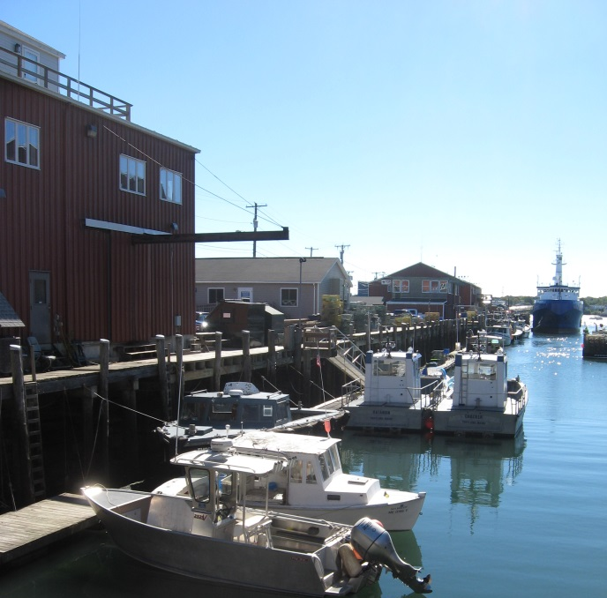
Functionally Water-Dependent
Primary purpose requires location on or direct access to waters and cannot be located away from these waters
MAINE DEPARTMENT OF ENVIRONMENTAL PROTECTION www.maine.gov/dep
Notes:
Structures and uses that are functionally water-dependent are not required to meet shoreline setbacks.
Helps protect commercial fisheries and maritime activities, and conserve points of access to waters.

Slide 38
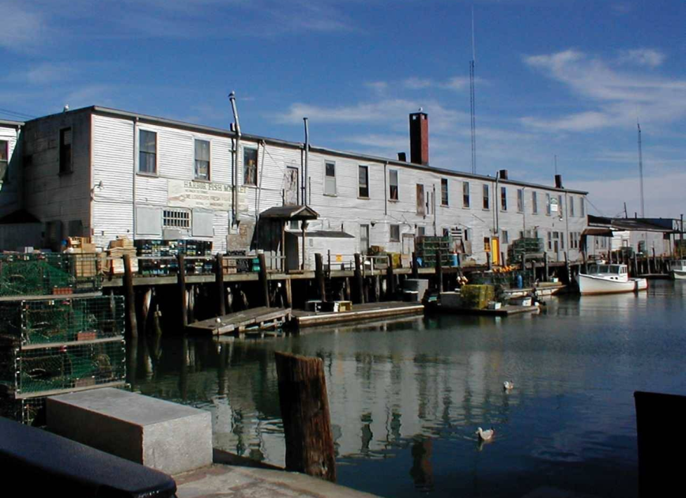
Definition
Functionally water-dependent:
Includes fish-related storage
Include shoreline structures necessary for erosion control purposes (in place of retaining walls)
Excludes recreational boat storage buildings (boat house)
MAINE DEPARTMENT OF ENVIRONMENTAL PROTECTION www.maine.gov/dep
Notes:
To be consistent with revisions in the Act

Slide 39
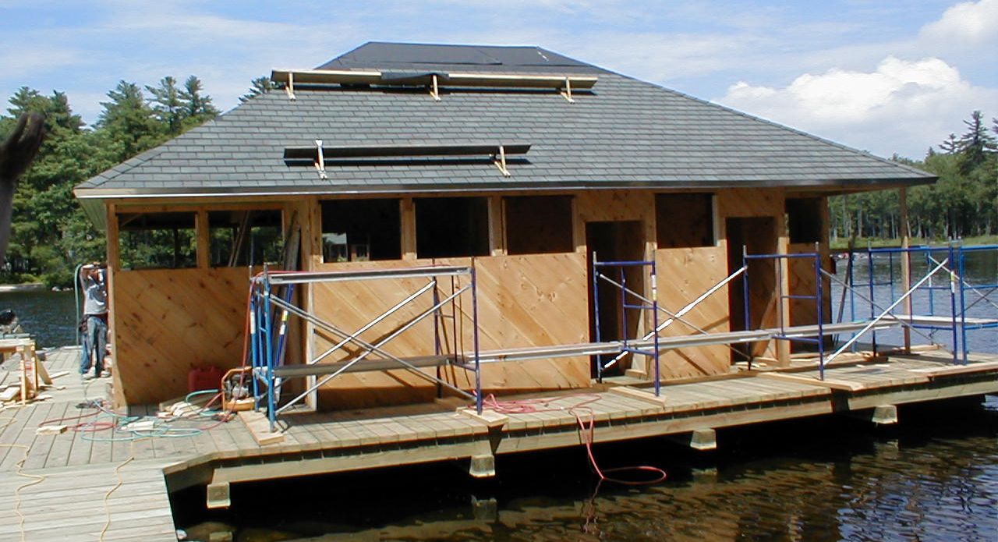
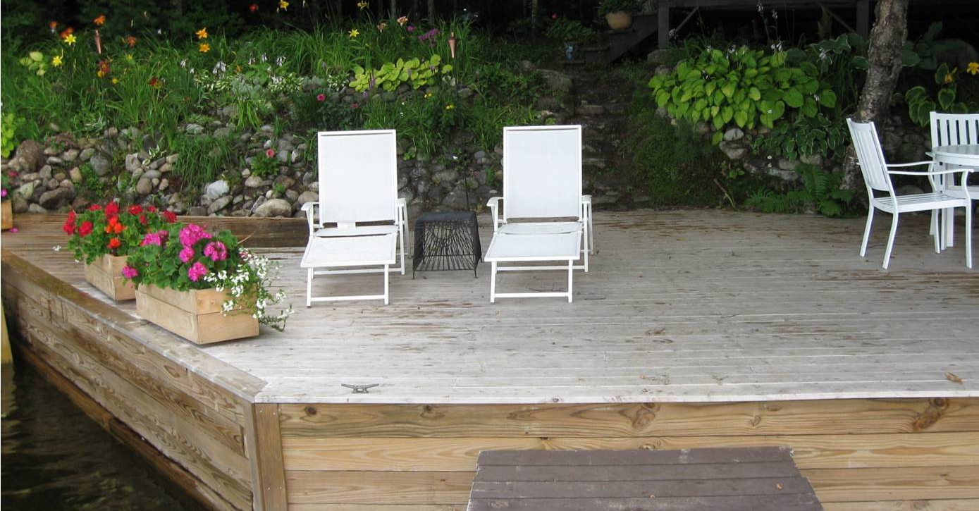
Setback Violations
If it looks like a duck…
MAINE DEPARTMENT OF ENVIRONMENTAL PROTECTION www.maine.gov/dep
Notes:
Common violations involve decks on the shoreline.
Others include patios and walkways within the shoreline setback area.
Newer violations include moored or docked structures (not watercraft)

Slide 40
Non-vegetated surfaces aka ‘lot coverage’
The total footprint area of all non-vegetated surfaces within the shoreland zone is limited (note that it does not say “impervious surfaces”).
Unintentional violations occur because the assumptions is often that it is impervious surface. This includes exposed ledge.
MAINE DEPARTMENT OF ENVIRONMENTAL PROTECTION www.maine.gov/dep
Notes:
Not just impervious surfaces.
Municipal officials may choose to include any or all of these exemptions from being included in the measurement of total non-vegetated surfaces

Slide 41
Non-vegetated Surfaces- aka: Lot Coverage
Surfaces include:
Structures
Driveways*
Parking areas*
Other areas from which vegetation was removed
Optional exemptions:
Naturally occurring ledge and rock outcroppings on lots existing on 3/24/90
Public boat launching facilities
*No exemption for grass paver type products
MAINE DEPARTMENT OF ENVIRONMENTAL PROTECTION www.maine.gov/dep
Notes:
Not just impervious surfaces.
Municipal officials may choose to include any or all of these exemptions from being included in the measurement of total non-vegetated surfaces

Slide 42
Naturally Occurring Ledge…
MAINE DEPARTMENT OF ENVIRONMENTAL PROTECTION www.maine.gov/dep

Slide 43
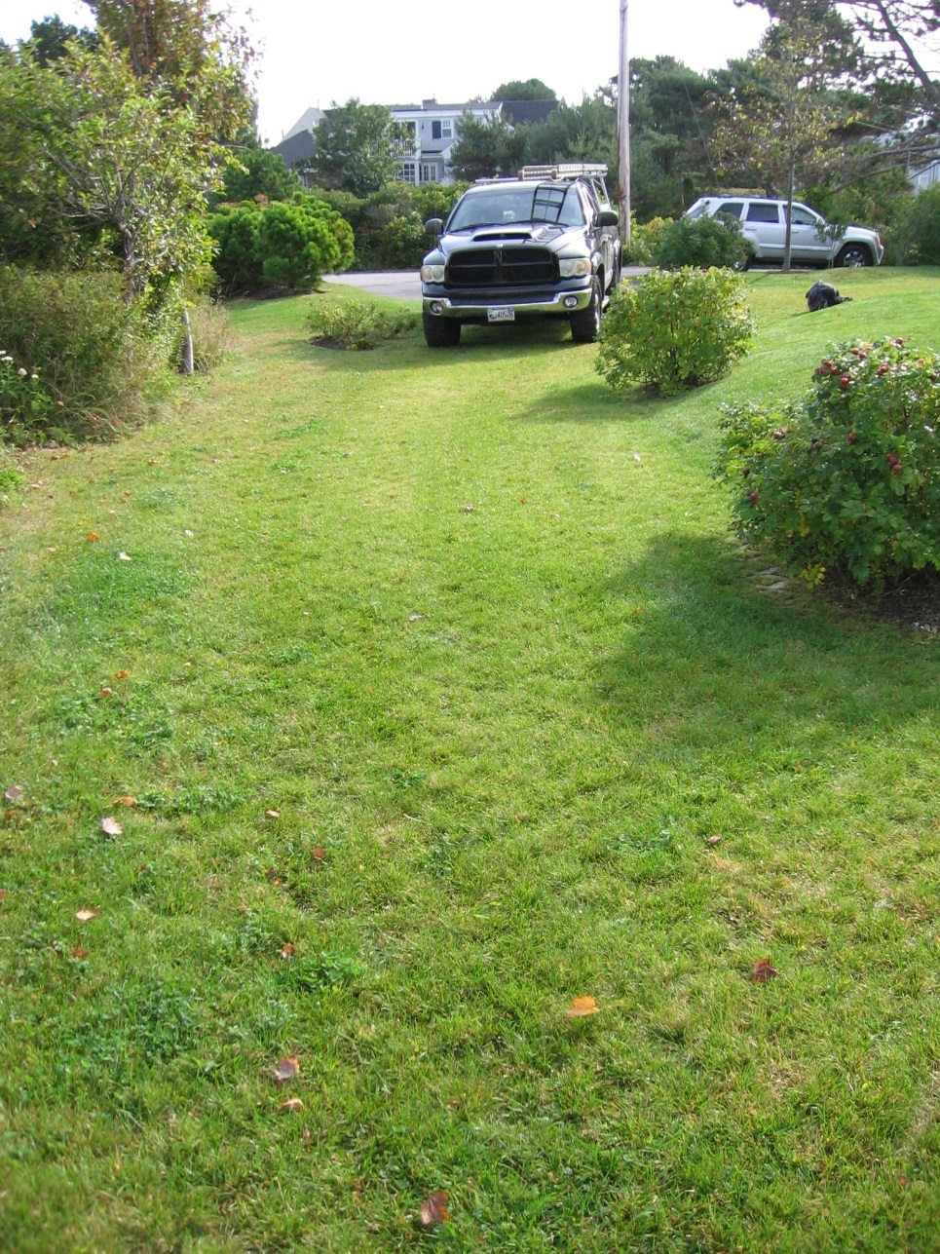
Grass Paver Products- Question
Can a municipal Code Enforcement Officer or planning board exempt areas using grass paver types of products from the lot coverage limitation?
MAINE DEPARTMENT OF ENVIRONMENTAL PROTECTION www.maine.gov/dep

Slide 44
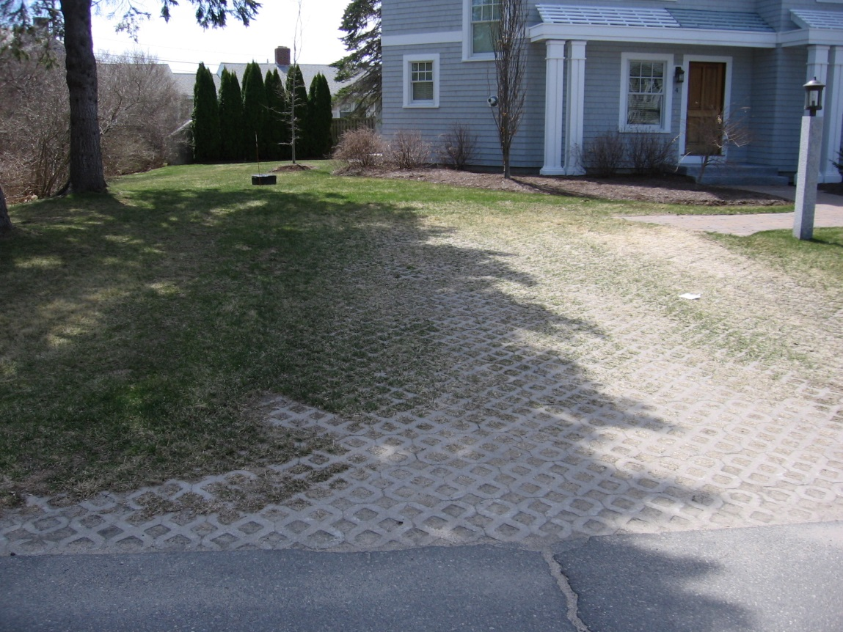
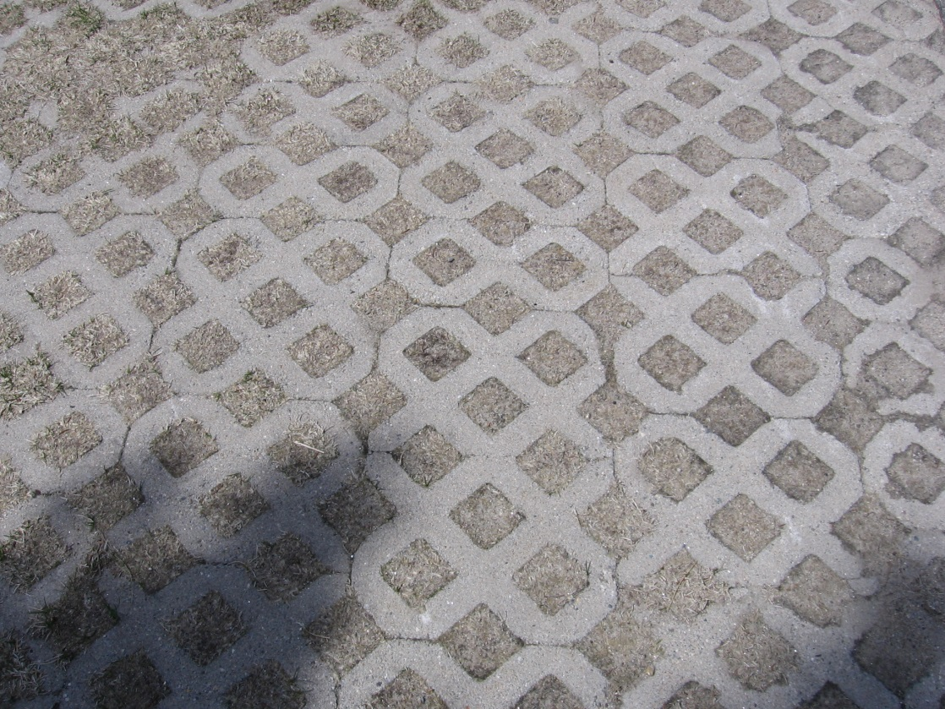
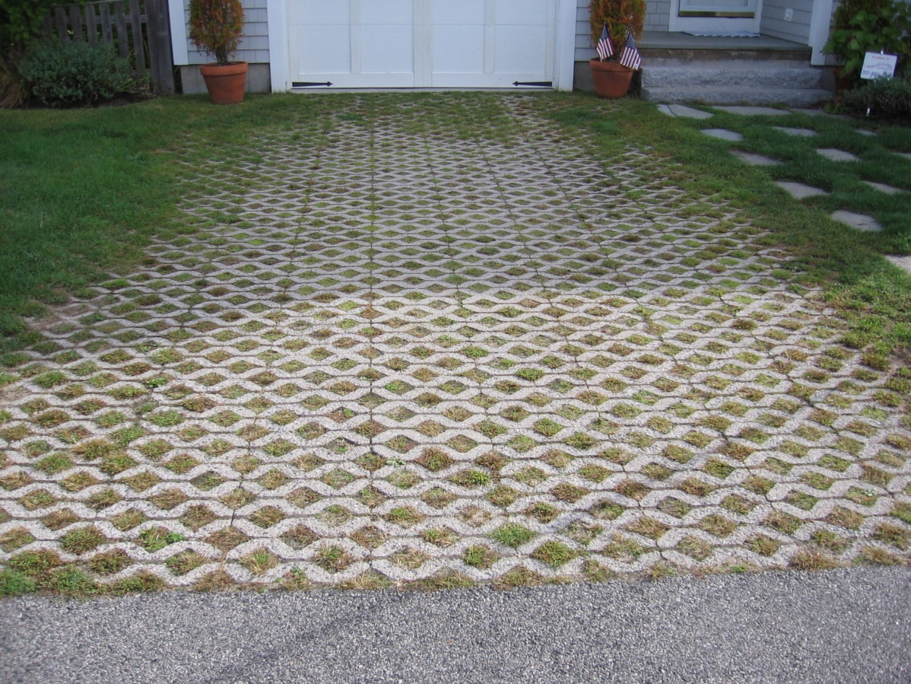
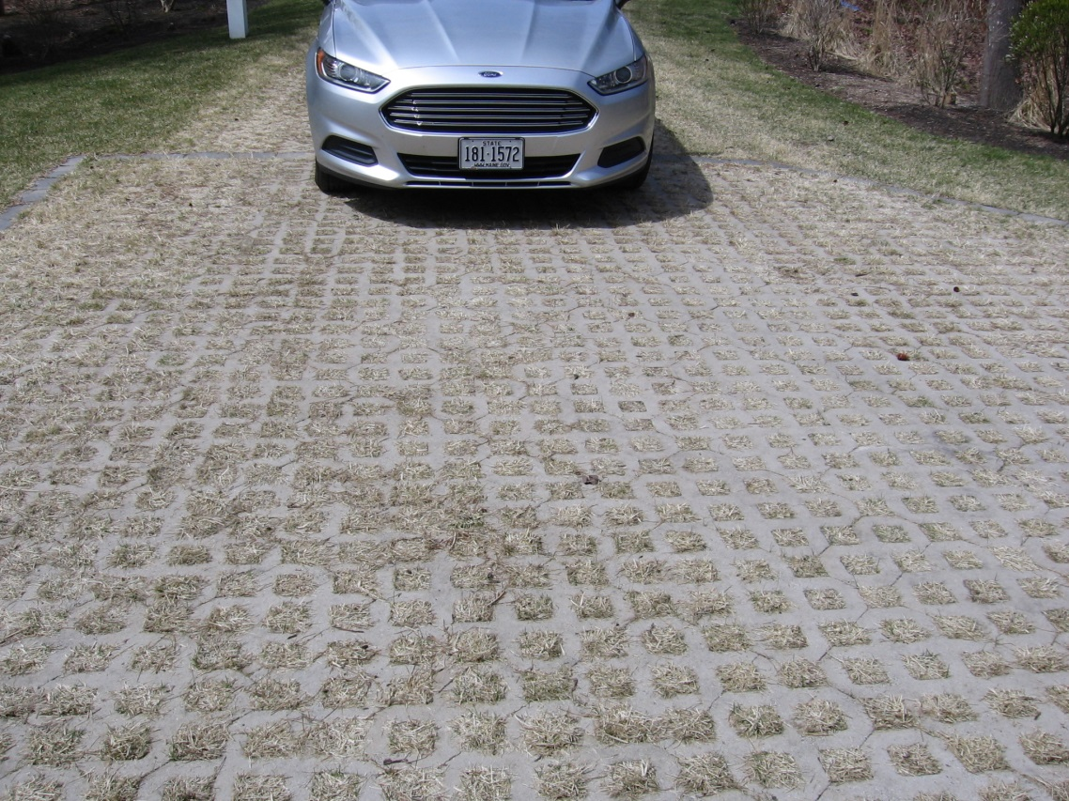
Grass (?) pavers…
MAINE DEPARTMENT OF ENVIRONMENTAL PROTECTION www.maine.gov/dep

Slide 45
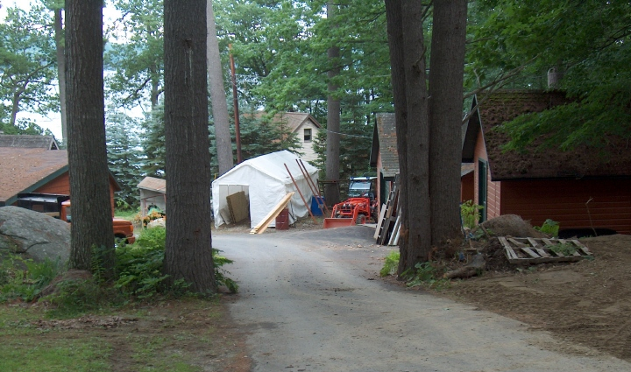
Non-Vegetated Surfaces
Total area is limited as percentage of lot area:
20% in most shoreland zone districts
70% in shoreland zone of coastal wetlands and rivers not flowing to great ponds where district is CFMA or GD
MAINE DEPARTMENT OF ENVIRONMENTAL PROTECTION www.maine.gov/dep
Notes:
Purpose
Prevent unintentional violations by requiring depiction on site plans
This standard often varies municipality to municipality

Slide 46
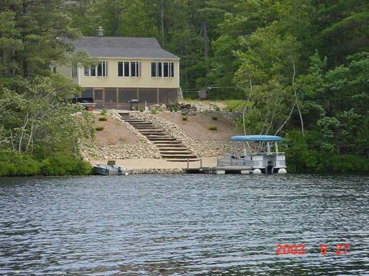
Non-vegetated surfaces…
MAINE DEPARTMENT OF ENVIRONMENTAL PROTECTION www.maine.gov/dep

Slide 47
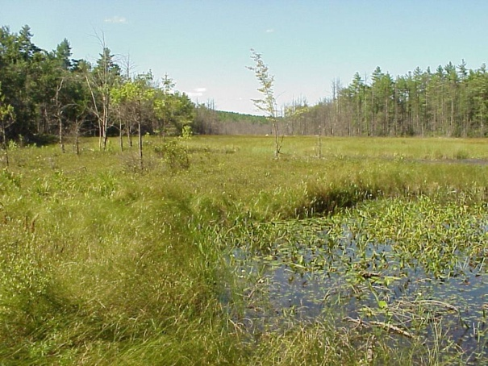
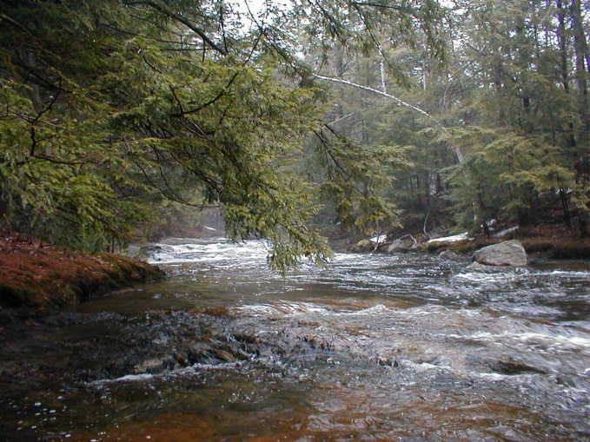
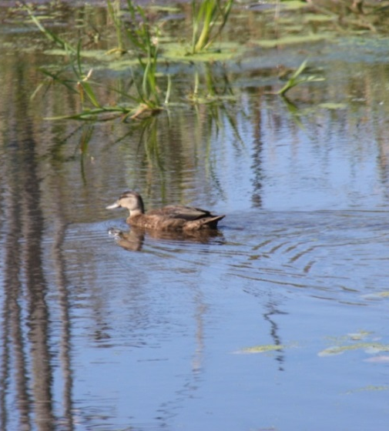
Vegetation Purposes
Vegetation is the cheap and natural way to:
Intercept and infiltrate stormwater runoff
Slow and control soil erosion and sedimentation
Provide bird & wildlife habitat, and shade aquatic habitat
Keep privacy and conserve natural character of Maine
MAINE DEPARTMENT OF ENVIRONMENTAL PROTECTION www.maine.gov/dep
Notes:
Vegetation standards help achieve shoreland purposes

Slide 48
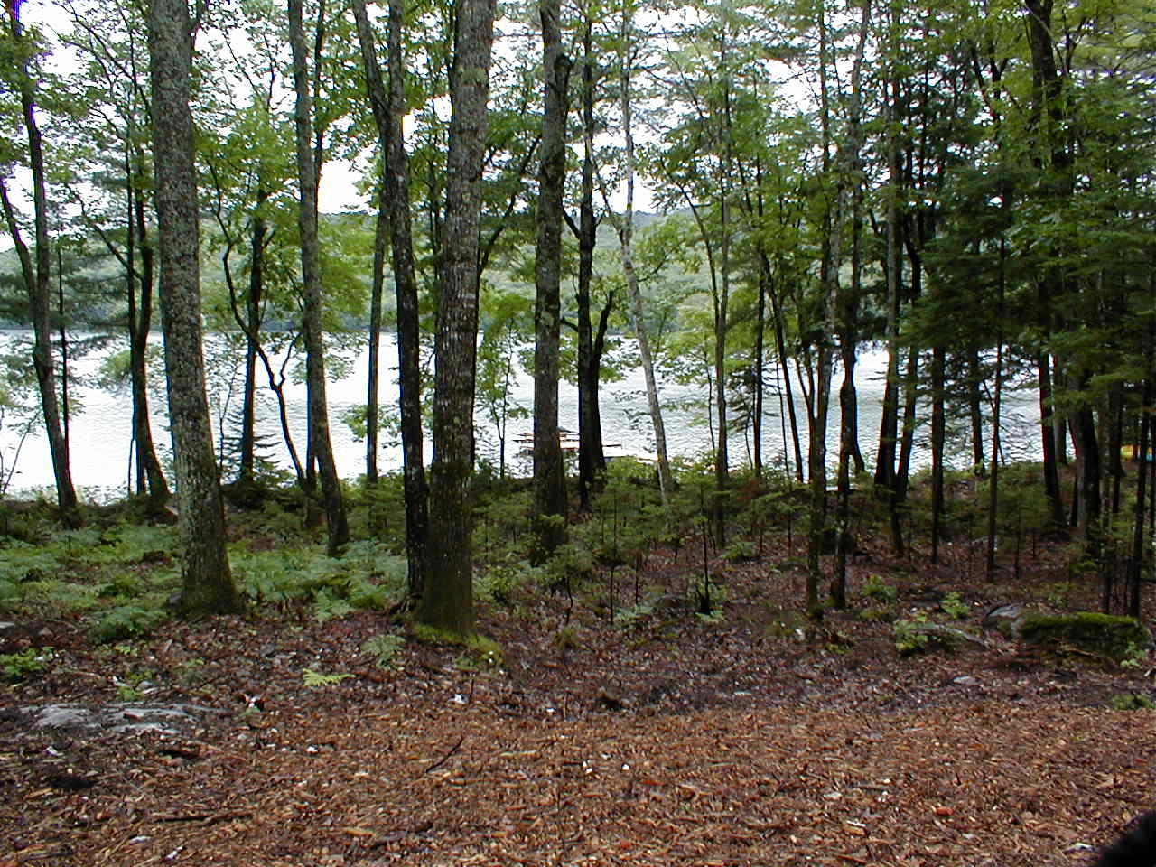
Shoreline Buffer Standards
Removal of vegetation is limited:
Within 100ft of great ponds & rivers flowing to great pond
Within 75ft of other rivers, streams and wetlands
Within 75ft of tributary streams (in the shoreland zone)
To canopy openings of less than 250 square feet
To a single meandering footpath
no wider than 6 ft;
To removing trees and saplings
based on a plot/point system;
To pruning live branches only
the bottom third of trees
MAINE DEPARTMENT OF ENVIRONMENTAL PROTECTION www.maine.gov/dep
Notes:
Help prevent unintentional violations by remembering that the setback is often the same as the buffer requirement
The plot system assigns points to trees based on diameter, and requires a certain number of points and saplings for each plot

Slide 49
Buffer Point System Well-Distributed Stand
25x50 plot area
24 points for great ponds, and rivers and streams flowing to great ponds
16 points for other waterbodies/wetlands
DBH (inches) Points
2<4 1
4<8 2
8<12 4
12 + 8
MAINE DEPARTMENT OF ENVIRONMENTAL PROTECTION www.maine.gov/dep
Notes:
A town has one or the other plot size, so points vary town to town. Plots are set up in area to be cleared. No clearing allowed if minimum points are not had.

Slide 50
Buffer Point System
>12” DBH = 8 points
>8”, <12”= 4 points
>4”, <8”= 2 points
>2”, <4” = 1 point
50’
2 x 8 = 16 points
2 x 8 = 16 points
2 x 4 = 8 points
25’
1 x 4 = 4 points
3 x 2 = 6 points
2 x 2 = 4 points
5 x 1 = 5 points
4 x 1 = 4 points
35 points
28 points
Great Pond

Slide 51
Buffer cut according to standards…
MAINE DEPARTMENT OF ENVIRONMENTAL PROTECTION www.maine.gov/dep

Slide 52
No cleared openings greater than 250 square feet within setback
MAINE DEPARTMENT OF ENVIRONMENTAL PROTECTION www.maine.gov/dep
Notes:
Within the setback

Slide 53
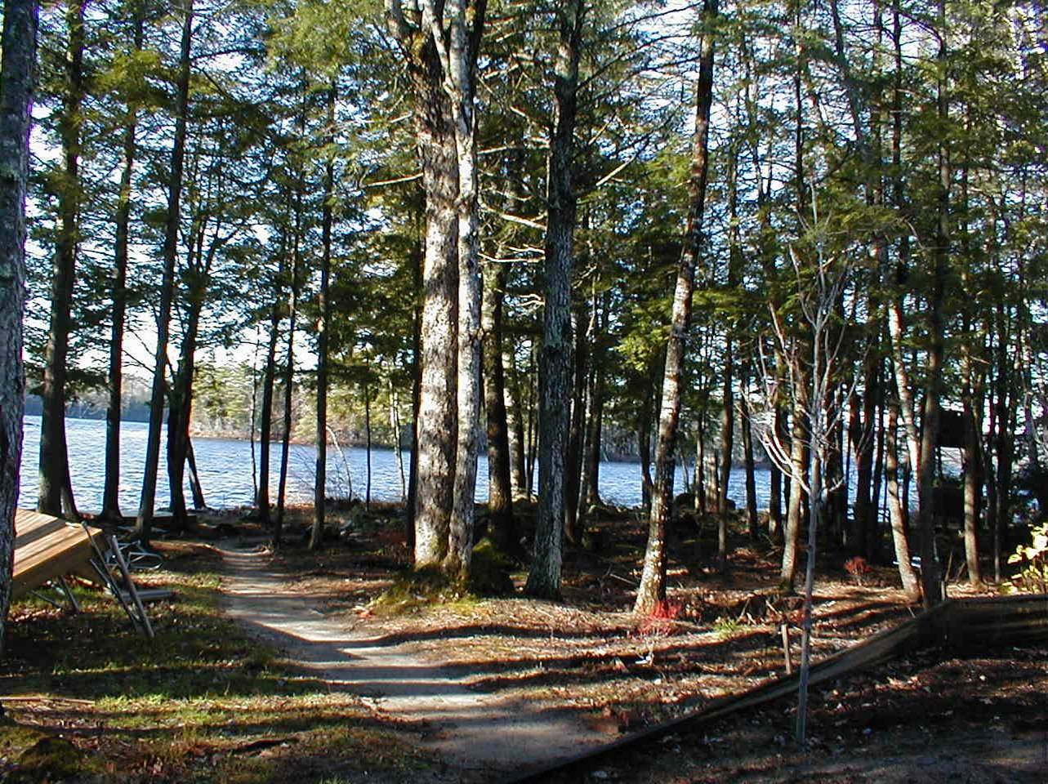
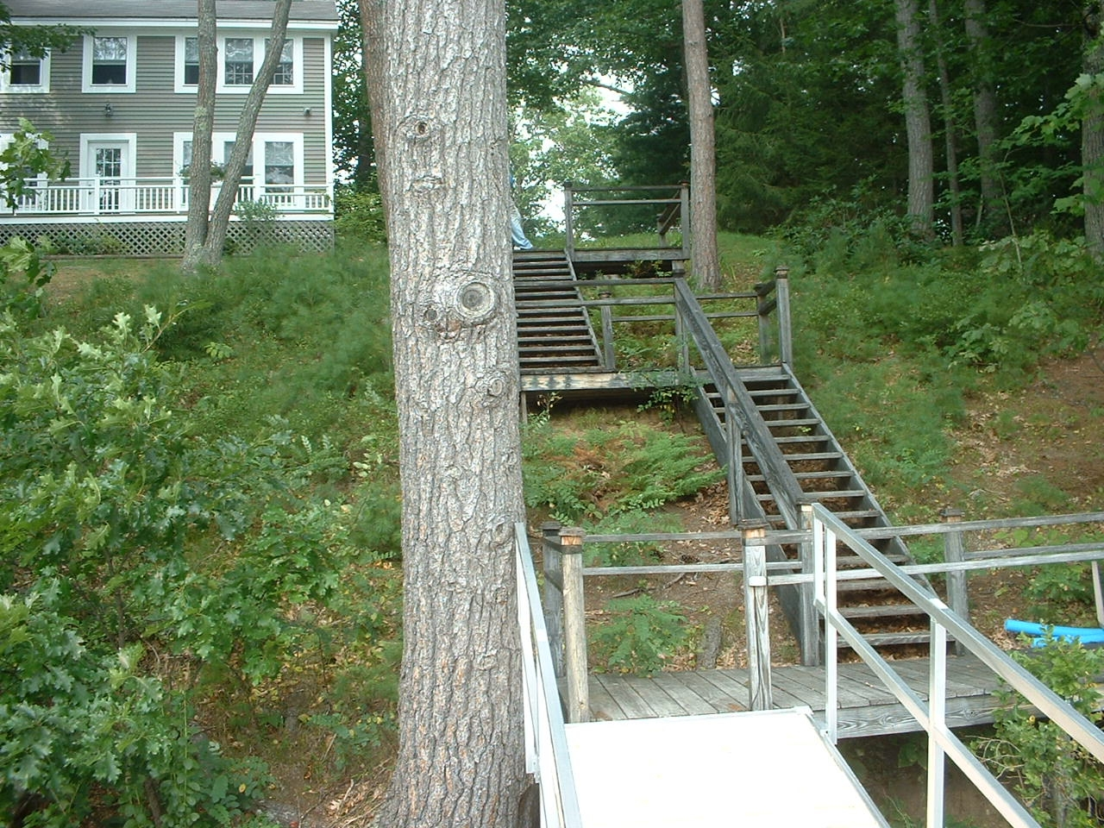
Vegetated Buffers Footpath/Staircase allowed Vegetation Plan
MAINE DEPARTMENT OF ENVIRONMENTAL PROTECTION www.maine.gov/dep
Notes:
A 6-foot wide, meandering footpath is allowed through the vegetated buffer for shoreline access. Any base material added, such as gravel or peastone, makes the path a structure as defined and is strongly discouraged.
The plot system using tree points can be complicated, and then having to investigate a complaint can be time-consuming. Most violations are clearly violations; still, it’s a good idea to encourage landowners to maintain a vegetation plan even when permitting is not required. The plan would show what vegetation they had, where they set up plots, and what vegetation they removed, and when.

Slide 54
Hazard Tree Defined
Definition for hazard tree:
structural defect…
under the normal range of environmental conditions, not:
hurricanes, hurricane-force winds,
tornados, microbursts, or
significant ice storm events
exhibits a high probability of failure…
will strike a target.
Area where personal injury or property damage could occur
roads, driveways, parking areas, structures, campsites, and any other developed area where people frequently gather and linger
also trees that pose imminent risk to bank stability.
MAINE DEPARTMENT OF ENVIRONMENTAL PROTECTION www.maine.gov/dep
Notes:
Defect that would result in failure under normal conditions, AND will strike a target. Without a target, it is not a hazard tree, except for trees posing a serious and imminent risk to bank stability.

Slide 55
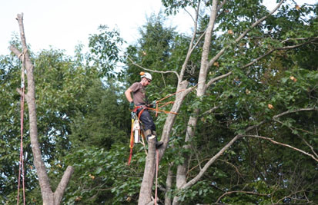
Hazard Trees
Within shoreline buffer:
Replace tree canopy opening > 250sf
new tree growth present or
Plant native trees at least 4ft in height and 2in DBH
No stump removal
CEO may require:
Professional evaluation
>1:1 for >8in DBH trees
Outside buffer:
Replace if tree volume or cleared openings exceeded
With new tree growth or
With native trees at least 2in DBH
MAINE DEPARTMENT OF ENVIRONMENTAL PROTECTION www.maine.gov/dep
Notes:
Consultation with CEO required
Municipal officials may choose to make standards more restrictive

Slide 56
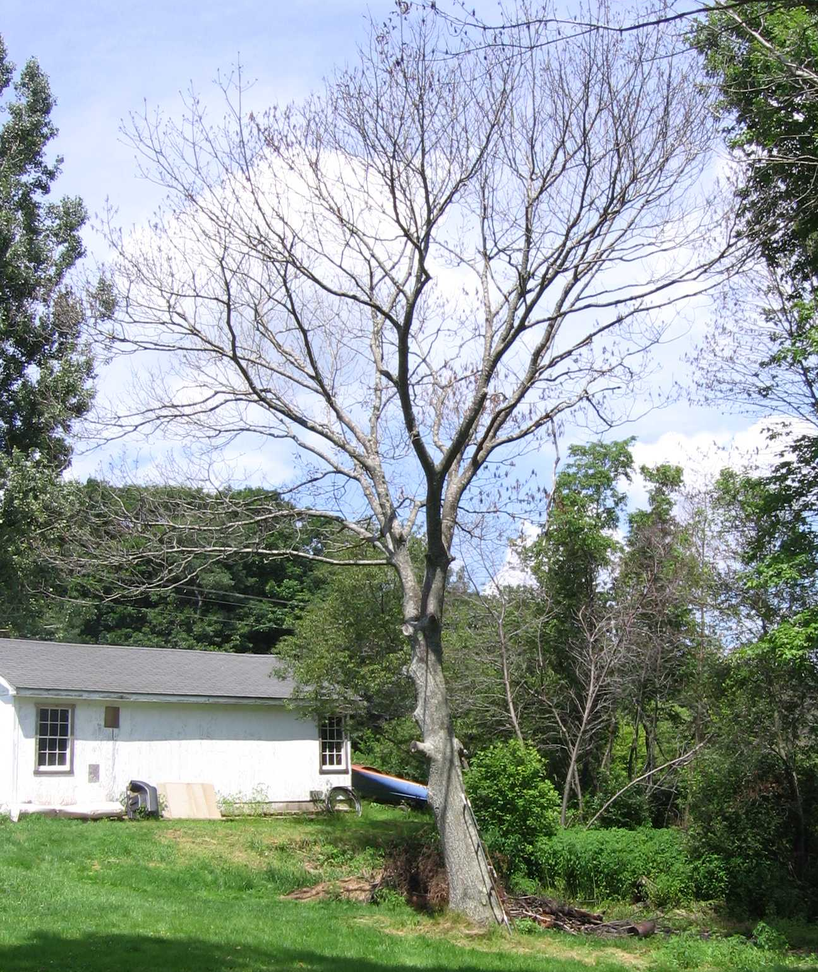
Dead Trees
Dead trees – contain no foliage during the growing season:
Removal allowed if dead from natural causes
No creation of new lawn areas or other permanently cleared areas
No stump removal
MAINE DEPARTMENT OF ENVIRONMENTAL PROTECTION www.maine.gov/dep
Notes:
No permit or consultation
Municipal officials may choose to make standards more restrictive

Slide 57
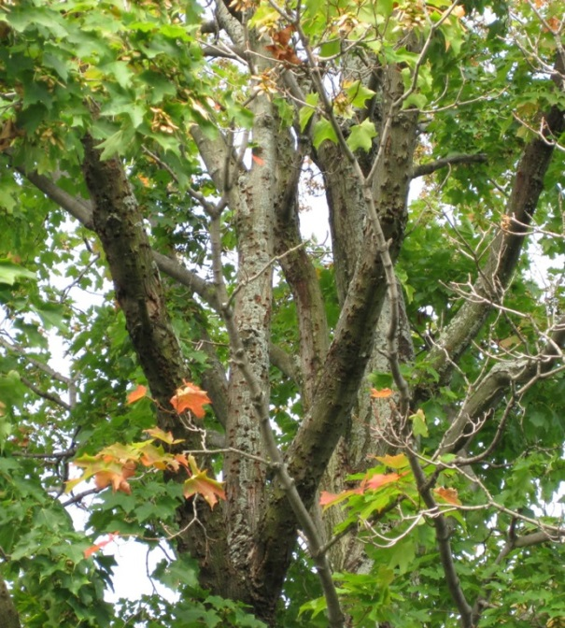
Storm-Damaged Tree Definition
Definition for storm-damaged tree:
a tree that is damaged beyond the point of recovery
as a result of a storm event.
Could be uprooted, blown down, lying on the ground, or still standing
MAINE DEPARTMENT OF ENVIRONMENTAL PROTECTION www.maine.gov/dep

Slide 58
Storm-Damaged Trees
Within shoreline buffer:
Pruning damaged limbs above 1/3 allowed
Replace tree canopy opening > 250sf
By natural regeneration or
With native seedlings or saplings, 1 per 80sf
No creation of new lawn or other cleared areas
No stump removal
Outside buffer:
Replace tree volume or cleared openings
By natural regeneration
With native seedlings or saplings on 1:1 basis
Regeneration must occur within 1 season
MAINE DEPARTMENT OF ENVIRONMENTAL PROTECTION www.maine.gov/dep
Notes:
Consultation with CEO required
Municipal officials may choose to make standards more restrictive

Slide 59
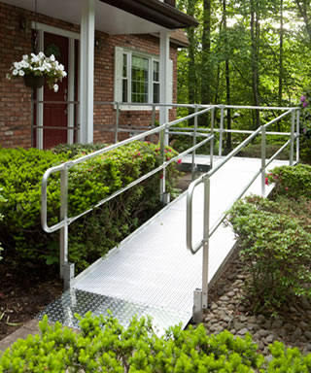
Administration: Disability Variances
Municipal officials may choose to:
Allow the CEO to issue a permit and disability variance for making dwelling accessible to person with disability
Please remember, required notices to DEP, just like any other variance!
MAINE DEPARTMENT OF ENVIRONMENTAL PROTECTION www.maine.gov/dep
Notes:
Alternatively, separate state statute gives board of appeals the authority to issue disability variance

Slide 60
NRPA vs. SLZ
NRPA administered by DEP
SLZ administered by municipality
NRPA applies to all field identified resources as defined
SLZ only applies to mapped resources as defined
NRPA more resources covered but lesser setbacks generally
SLZ fewer streams and wetlands but greater setbacks generally
NRPA adjacency standards vary from SLZ buffer standards
NRPA purpose includes water quality and habitat protection
SLZ additional purposes include development density, traditional land use, flooding and aesthetics.
MAINE DEPARTMENT OF ENVIRONMENTAL PROTECTION www.maine.gov/dep

Slide 61
Basic Review Standards- Question
If DEP issues a permit under the Natural Resources Protection Act (NRPA), can a municipality approve a project on that basis?
MAINE DEPARTMENT OF ENVIRONMENTAL PROTECTION www.maine.gov/dep
Notes:
If it appears that a dimensional standard cannot be met legitimately, refer the applicant to the board of appeals.
FOF are required when denying applications, but it is also a good idea when you approve applications in case of any aggrieved party

Slide 62
NRPA & SLZ
If DEP approves a Permit by Rule or other permit under the NRPA, a project must still separately comply with all shoreland zoning provisions in order for the municipality to grant a shoreland zoning permit.
MAINE DEPARTMENT OF ENVIRONMENTAL PROTECTION www.maine.gov/dep
Notes:
This means that if a project is approved by the Department, it still needs to be reviewed to meet local shoreland zoning standards.

Slide 63
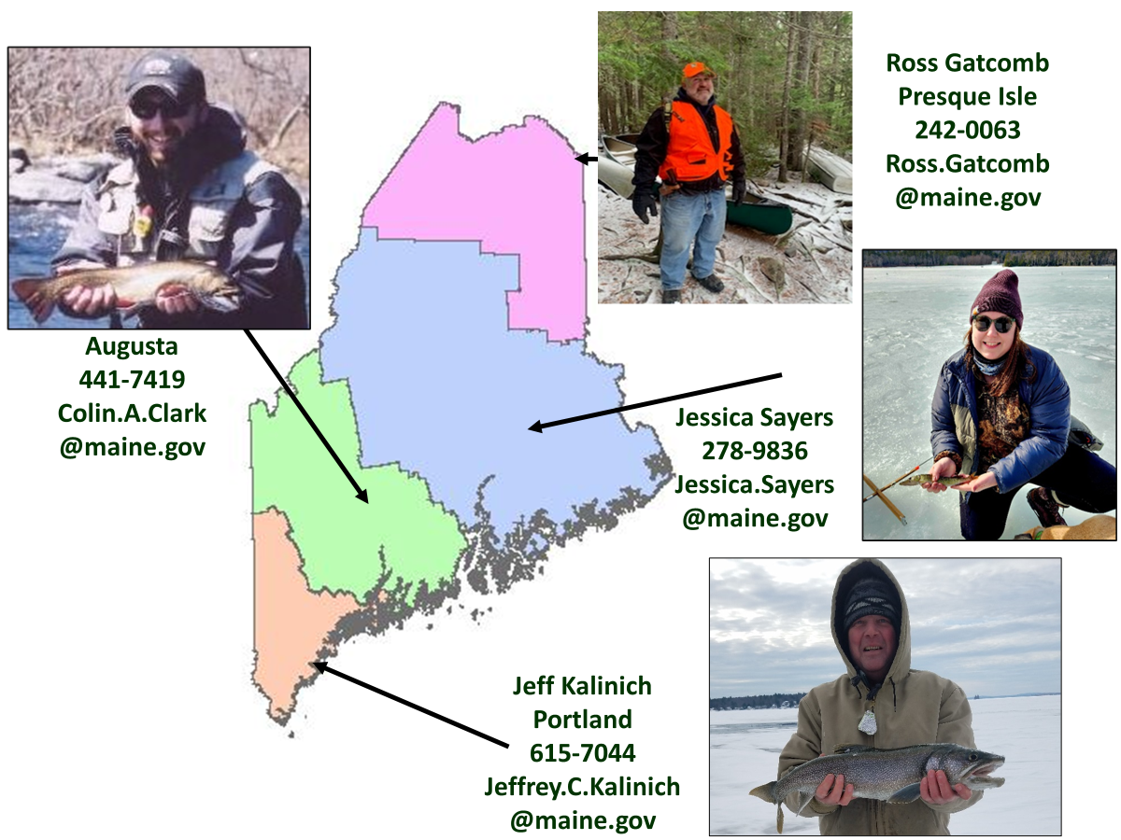
Shoreland Zoning Program
Notes:
Please don’t hesitate to call us when you have questions.

