Slide 1
Sustainable Waste Management
ecomaine’s services, strategies, and tools for resident engagement
toward landfill diversion based on the solid waste hierarchy
Matt Grondin, Director of Communications & Public Affairs
March 2, 2023

Slide 2
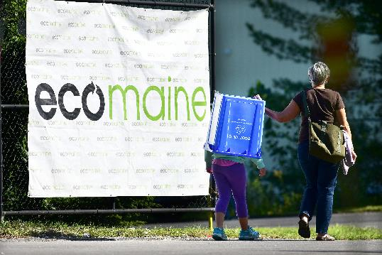
Our mission
ecomaine provides comprehensive long-term solid waste solutions in a safe, environmentally responsible, economically sound manner, and is a leader in raising public awareness of sustainable waste management strategies.
The annual ecomaine Open House
Notes:
Mission – municipally owned non-profit. As long as we cover costs, we’re good. Meet the mission – will talk about each part of our org that focuses on this.
Mention pic from Open House…

Slide 3
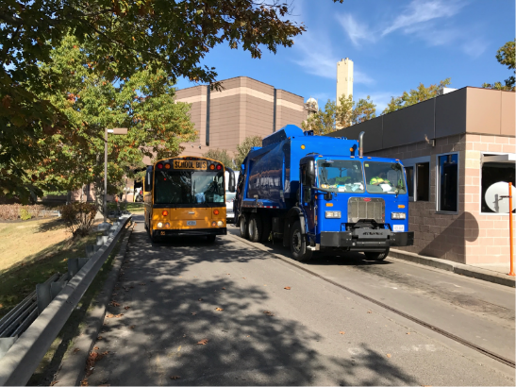
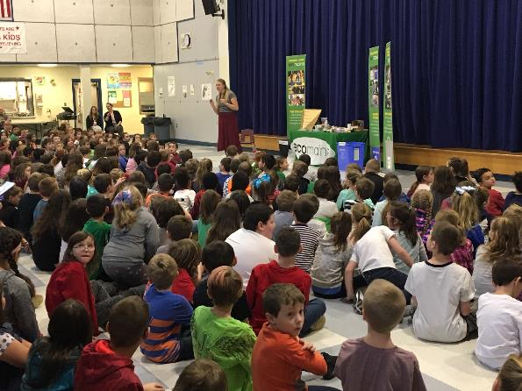
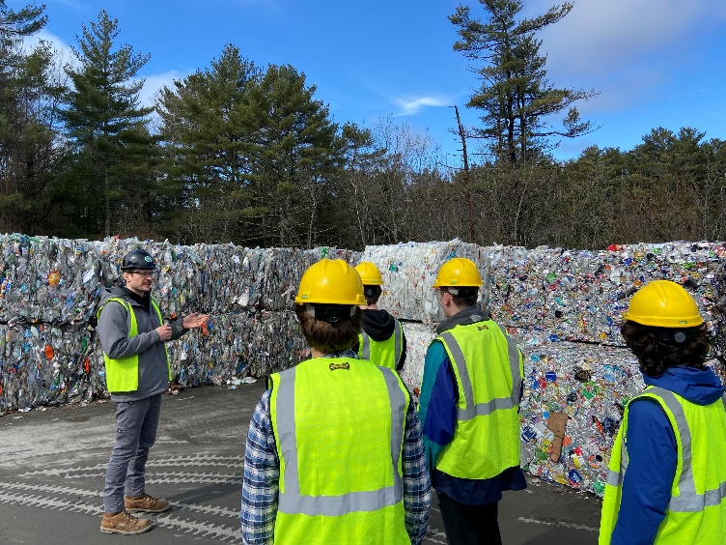
Facilities & Programs
73 Communities
~450,000 people
Facilities:
Single-Sort Recycling
Food Waste / Organics Recovery
Waste-To-Energy Plant
Landfill/Ashfill
Programs:
Tours & School Presentations
School Grants & Outreach
Earned & Paid Media
Social & Digital Media
Fairs and Events
Now offered virtually!
Notes:
Services, facilities, & programs – 35-40K tons of RCY, 175-180K tons of MSW + 264-acre landfill.
Reached more than 73,000 people last year!
Education now offered virtually as well! Will briefly describe each facet of our organization.

Slide 4
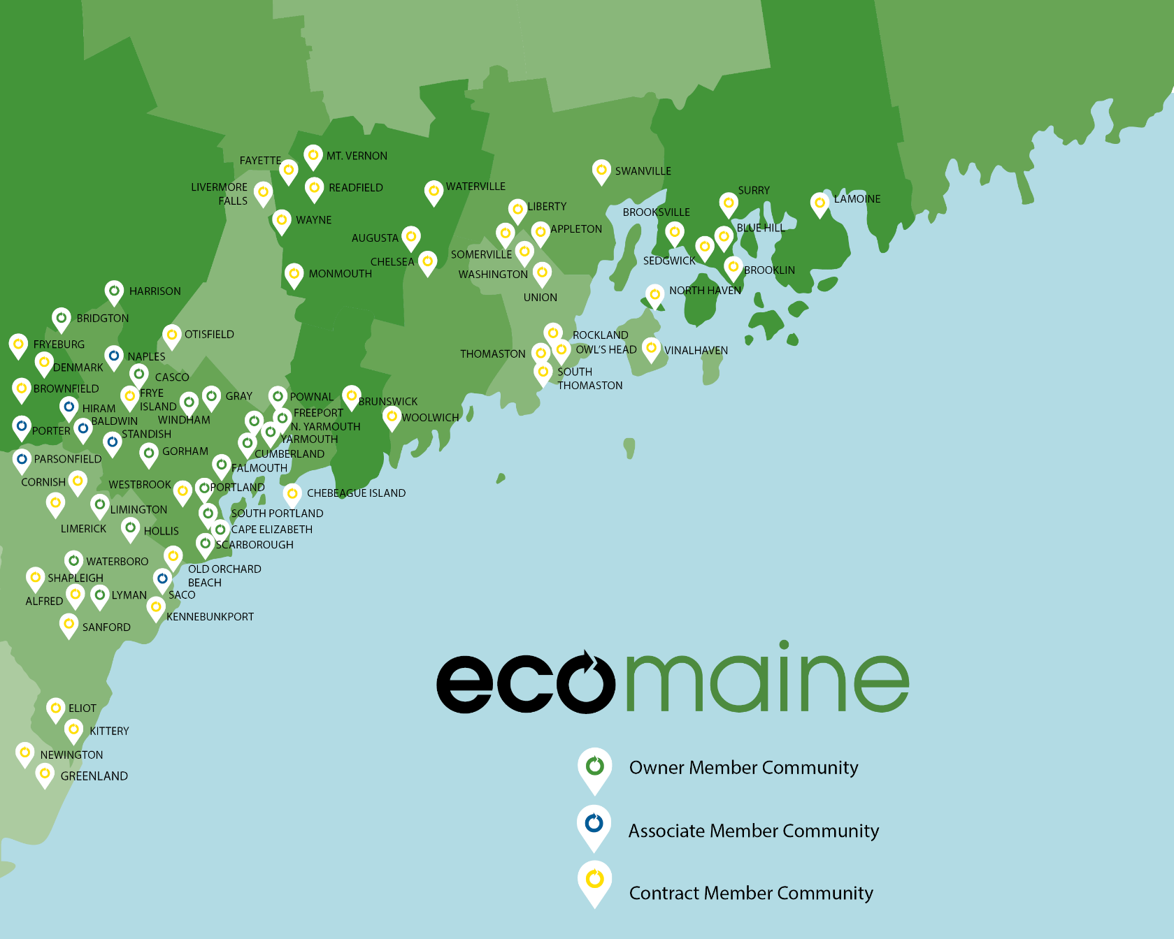
Our Members
Notes:
Communities – a regional effort. And growing. Even as far as Swanville, Blue Hill/Surry, and Lamoine via the DM&J model.

Slide 5
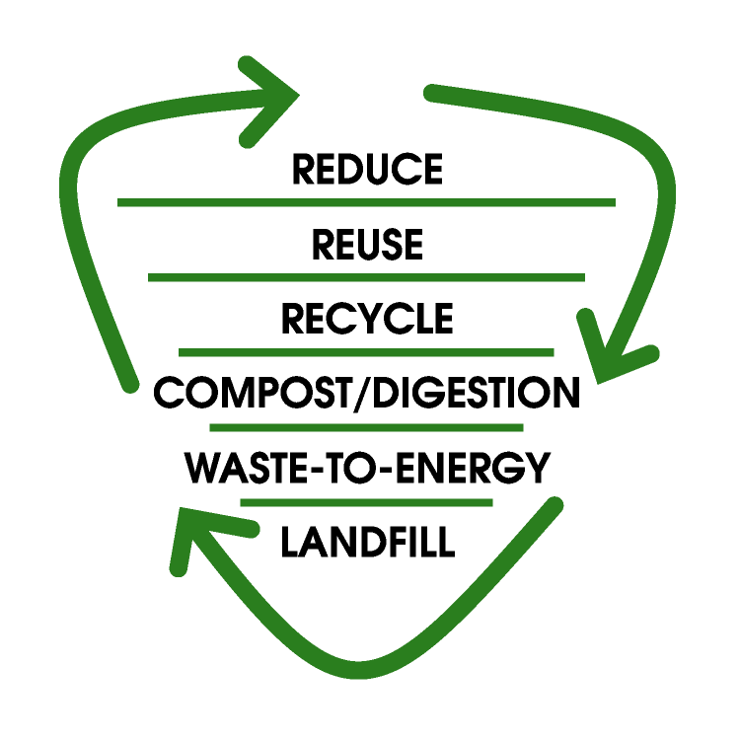
Solid Waste Hierarchy
Notes:
This is the goal. Waste Hierarchy is what we strive for – state statute, EPA guidance… Preference for landfill diversion.

Slide 6
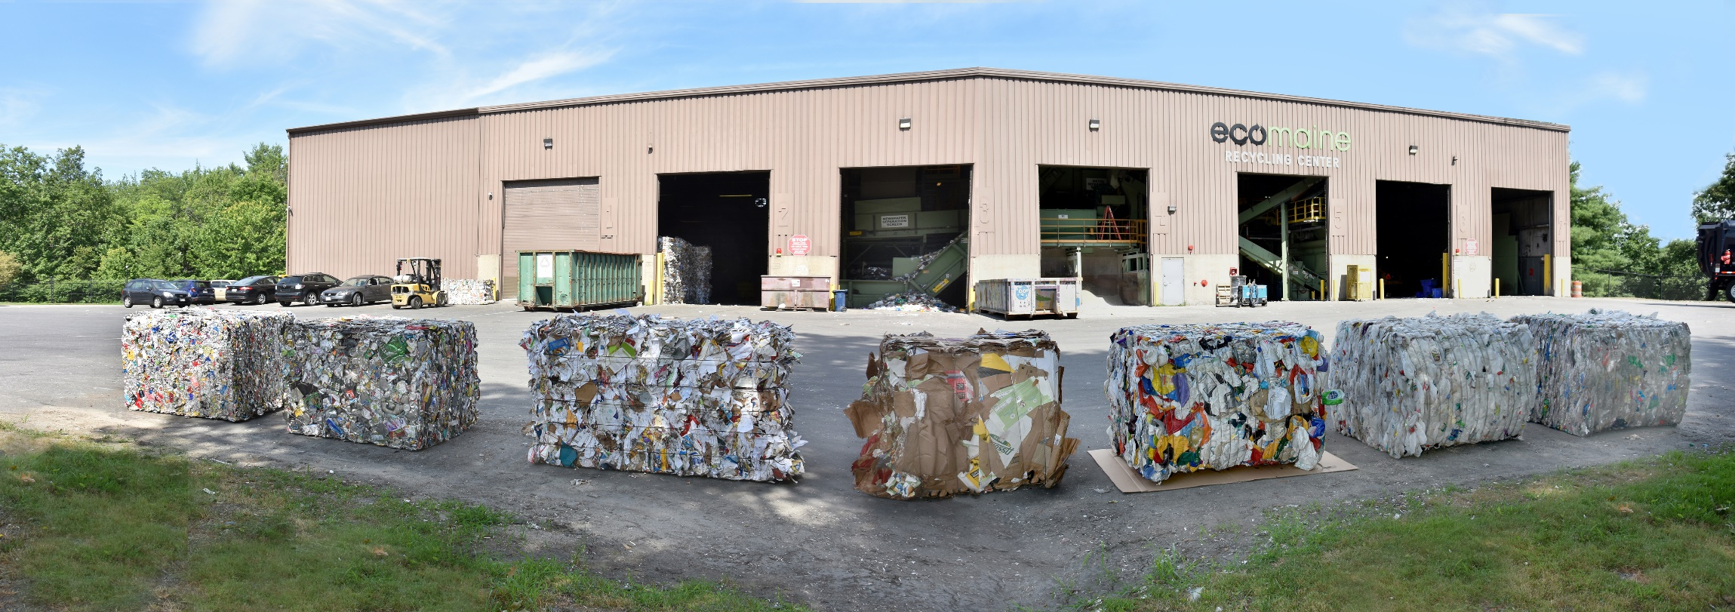
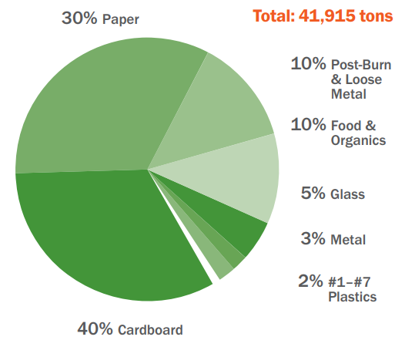
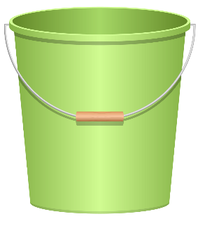
Single Sort Recycling
Paper
Cardboard
Metal Cans
Foil
Pots & Pans
Rigid or Hard Plastic Containers #1-7
Glass Bottles & Jars
Notes:
These are the scrap commodities we accept. There are markets for all of them – will talk about pricing on my next slide, but we are moving all materials to end markets.
Cardboard passed mixed paper for the first time last year – home delivery/pandemic impact.
(Talk about difference of glass)

Slide 7
Recycling Markets
15 years, full circle!
Notes:
This past year has been lower again, but this is cyclical, and the economics are secondary – RCY is primarily a landfill diversion strategy, then used to meet manufacturing production needs, then as a revenue generator.

Slide 8
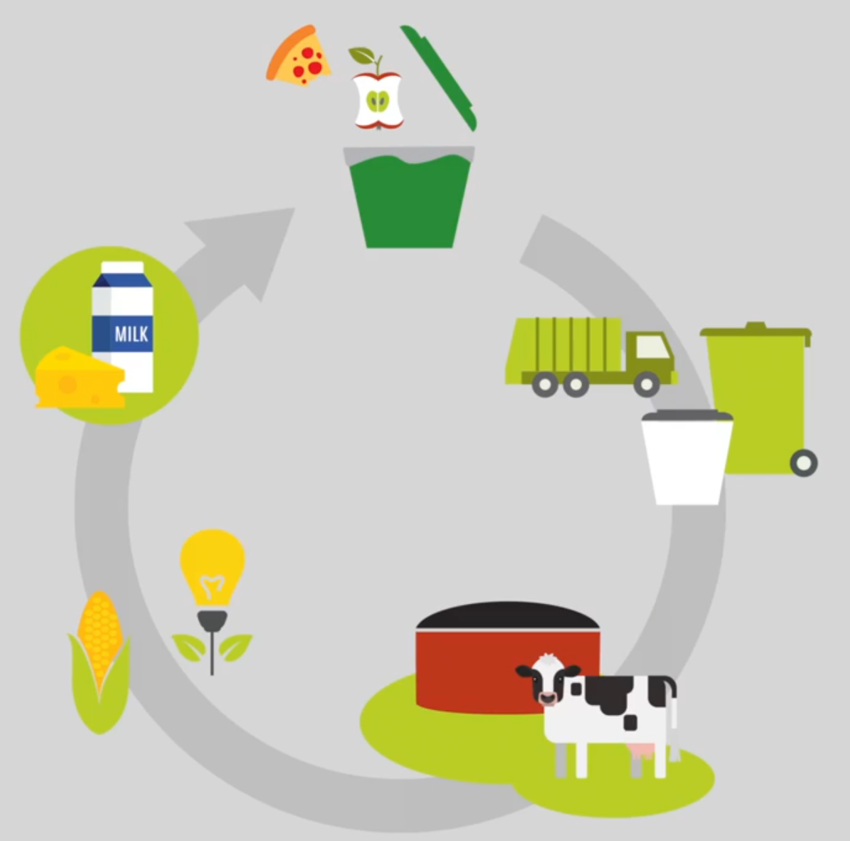
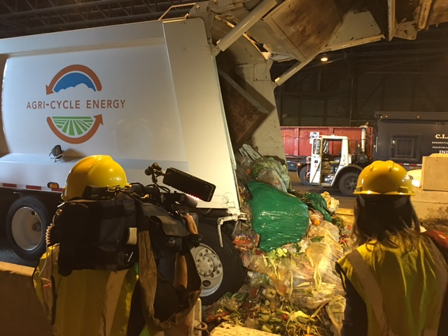
Food Waste / Organics
Notes:
Ecomaine also serves as a consolidation point for Agri-Cycle, which does anaerobic digestion (not composting) -- Process description.
Mostly businesses – Hannaford, schools, corporate cafeterias, etc. But a couple of muni’s, too.

Slide 9
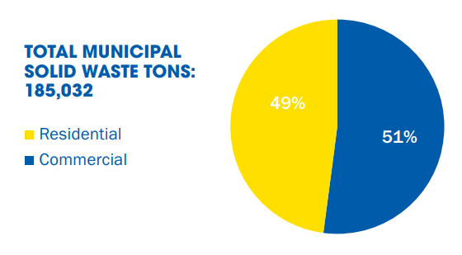
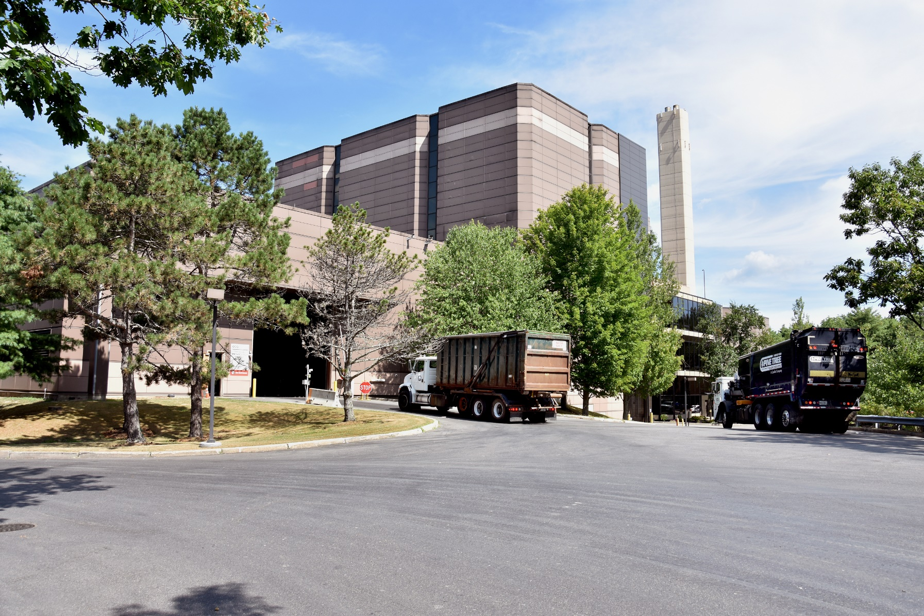
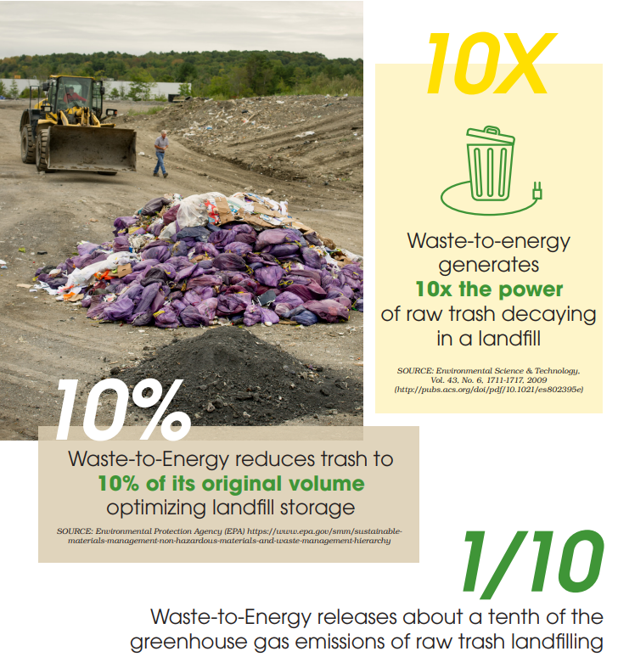
Waste-to-Energy
Notes:
WTE is up one step from LF on Hierarchy, mainly due to better energy recovery, reduction in volume, and better GHG mitigation (LFs = methane).
Benefits are that we’re generating more electricity, landfilling less, and releasing fewer GHGs thru WTE.
All while controlling for pollution…

Slide 10
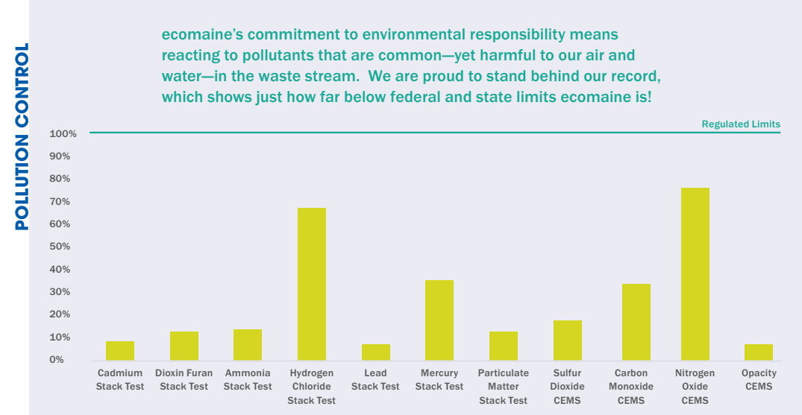
Environmental Management
Notes:
…we monitor for several pollutants and are proud to be under all state and federally-mandated limits – oftentimes VERY far below those limits.
We are certified ISO 14001 for EMS and ISO 45001 for safety – we are externally audited and take this extremely seriously.

Slide 11
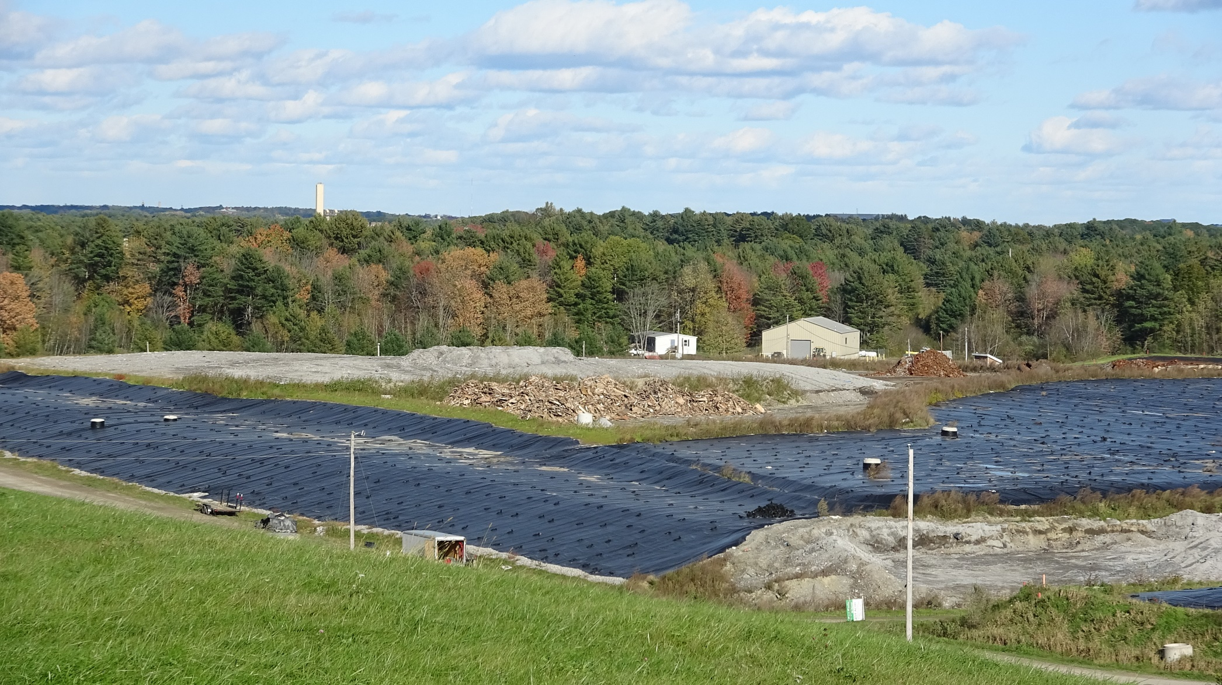
Ashfill / Landfill
Notes:
Also recover post-burn metal as part of the WTE process before it goes to our LF, which is only 3 miles down the road. Lucky to have it close by, close to urban center.
Careful about what we put into our LF – recover all that we can to save space.
LFs in Maine and especially in SNE are filling up – ours would have been full long ago if not for the 90% reduction in volume thru WTE mentioned earlier!

Slide 12
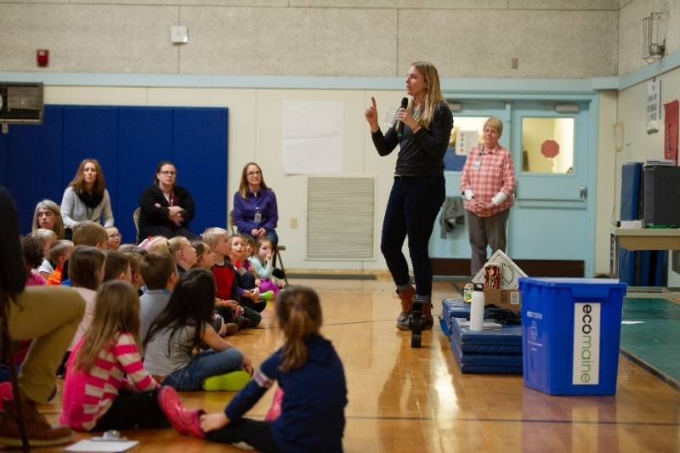
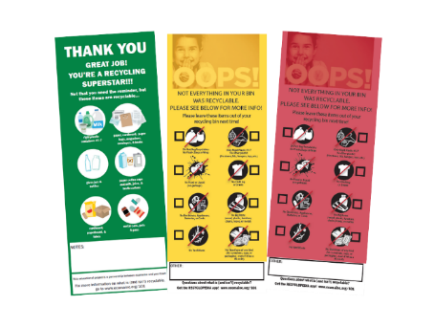
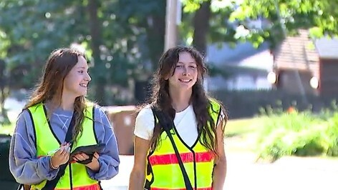
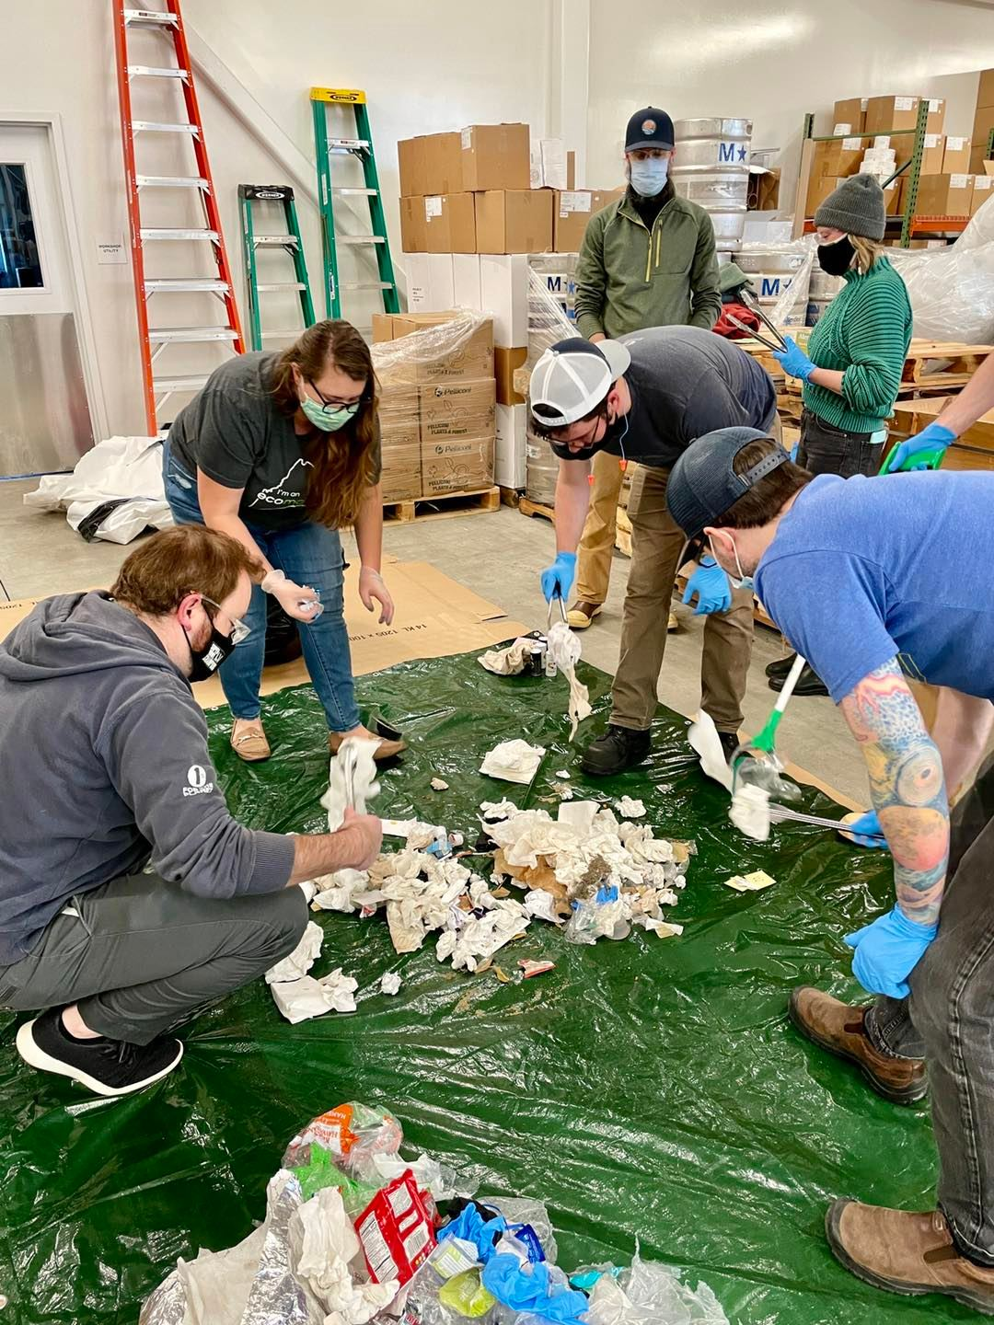
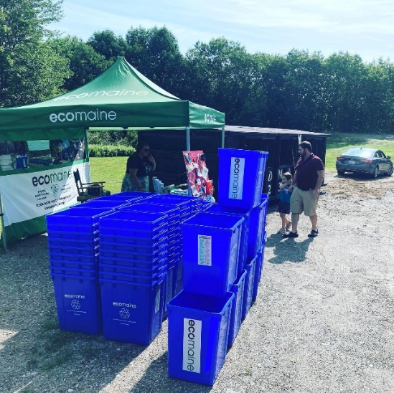
Outreach
Presentations
Tours
Tabling at Events
Grants
Painting Contest
Eco-Excellence Awards
Upcycle Challenge
Tagging Program
Open House
Master Recycler Course
Activities
Waste Audits
In Schools
At Transfer Stations
Town Meetings
Community Days
Libraries
Community Centers
Recyclopedia
Info & Resources
Social Media
Community TV Videos
Courtesy of:
Three Full-Time
Education Staff & Additional Interns
Notes:
Education is the ecomaine difference.
We reached 73K+ last year, and we’re on pace to do it again this year. Thru all sorts of activities, education, programming, grants, contests, media, and more!
3 FTEs plus me plus interns. Big time dedication to community outreach. Not unique in the industry, but it’s not too common, either!

Slide 13
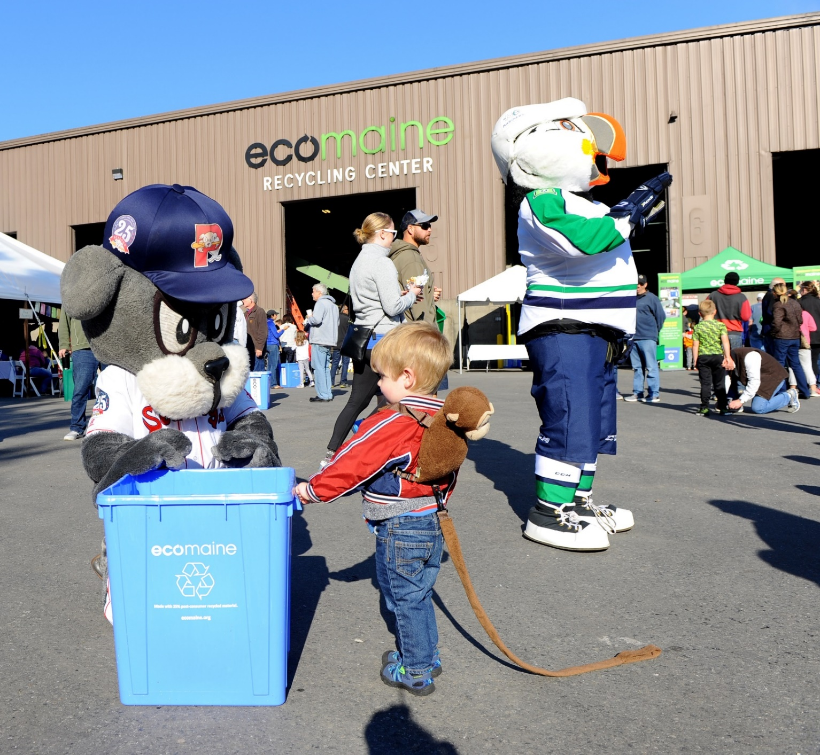
Thank you!
Matt Grondin
Director of Communications & Public Affairs
207-523-3108
grondin@ecomaine.org
Notes:
Thank you for the chance to talk about ecomaine – I welcome your Q’s.

